Slide 1
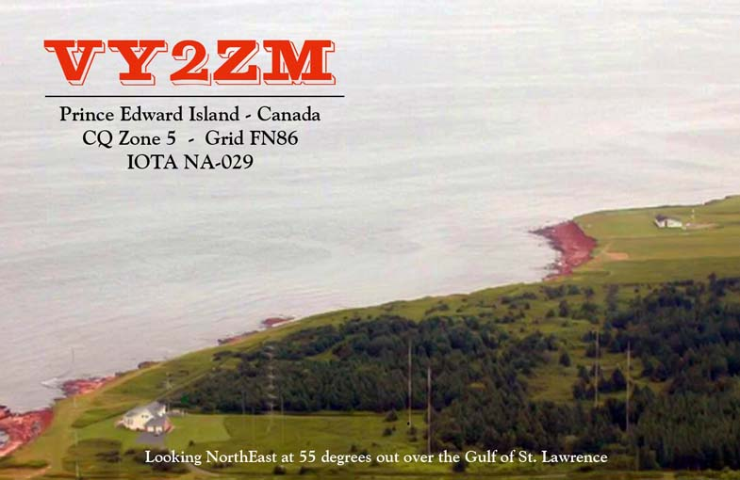
Contesting from VY2ZM on PEI

Slide 2
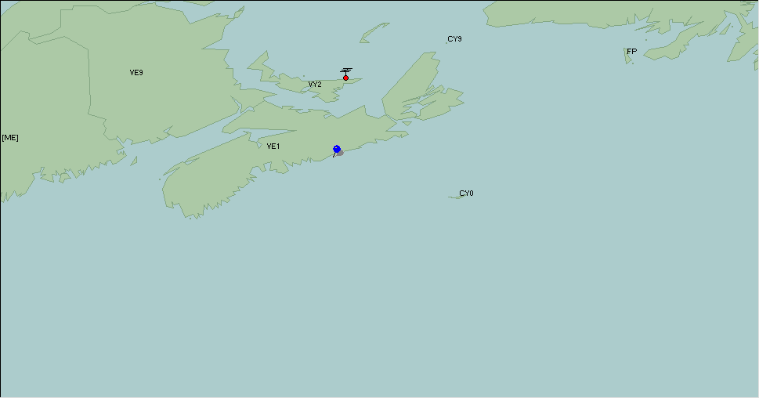
VY2ZM Location Vs. VE1ZZ

Slide 3
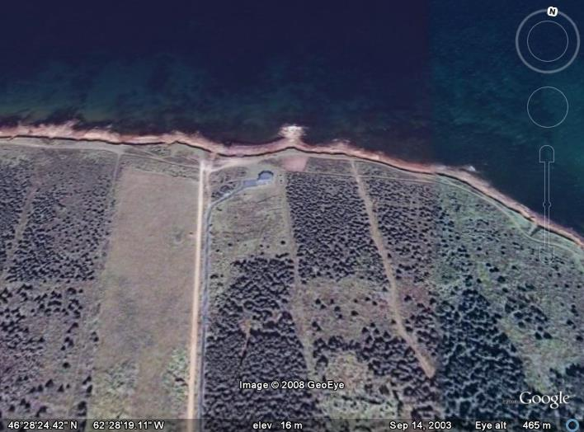
Google Earth 46'28''N 62'28”W

Slide 4
The Early Start Up Years
2000 Visited PEI to find a dream location
2001 We built a home and 160 2 x 2 Array
2002 Added 80m 4Sq and Basic 40-10 System
2003 Stacks Built for 40/20/15/10
2007 40m 3/3 added on 170ft tower
2008 6/6 OWA Stacks Added for 15m
2009 Installed 3 x 3 Vertical 80M BS/EF Array
2010 – 2016 Ongoing Maintenance/Upgrades

Slide 5
Key Design Principles
Lowband Vertical Systems Placed at Seaside
Sited Towers To Allow Unimpeded Access to EU
Optimized Vertical Array Steering for Contesting
Limited Boom Lengths to 36 feet for Survival
Employed M2/Orion Rotors to turn yagis in wind
Did not use Rotatable Sidemount Systems
Employed Specialized Rx Array for 160m Dx'ing

Slide 6
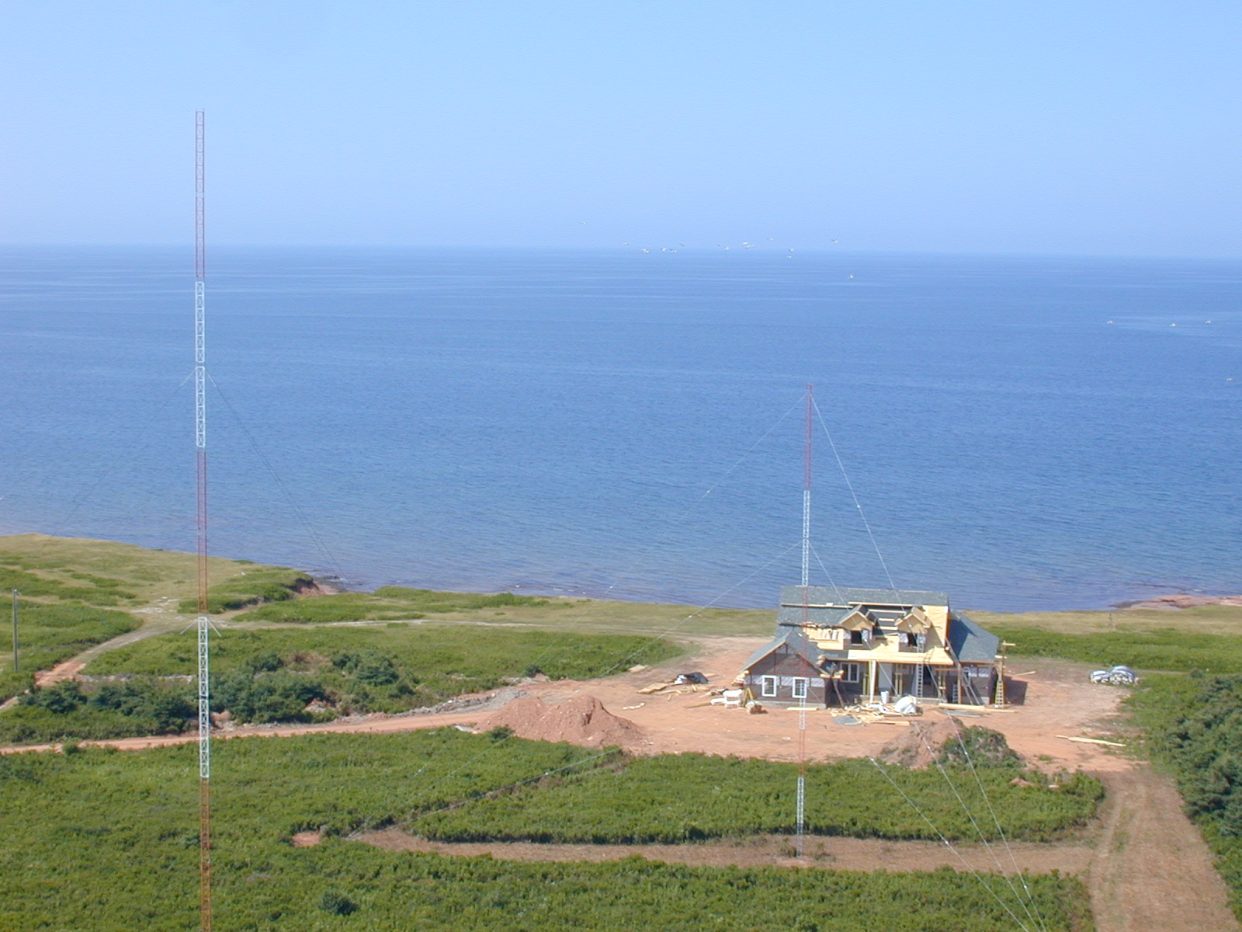
House and Ants in Progress

Slide 7
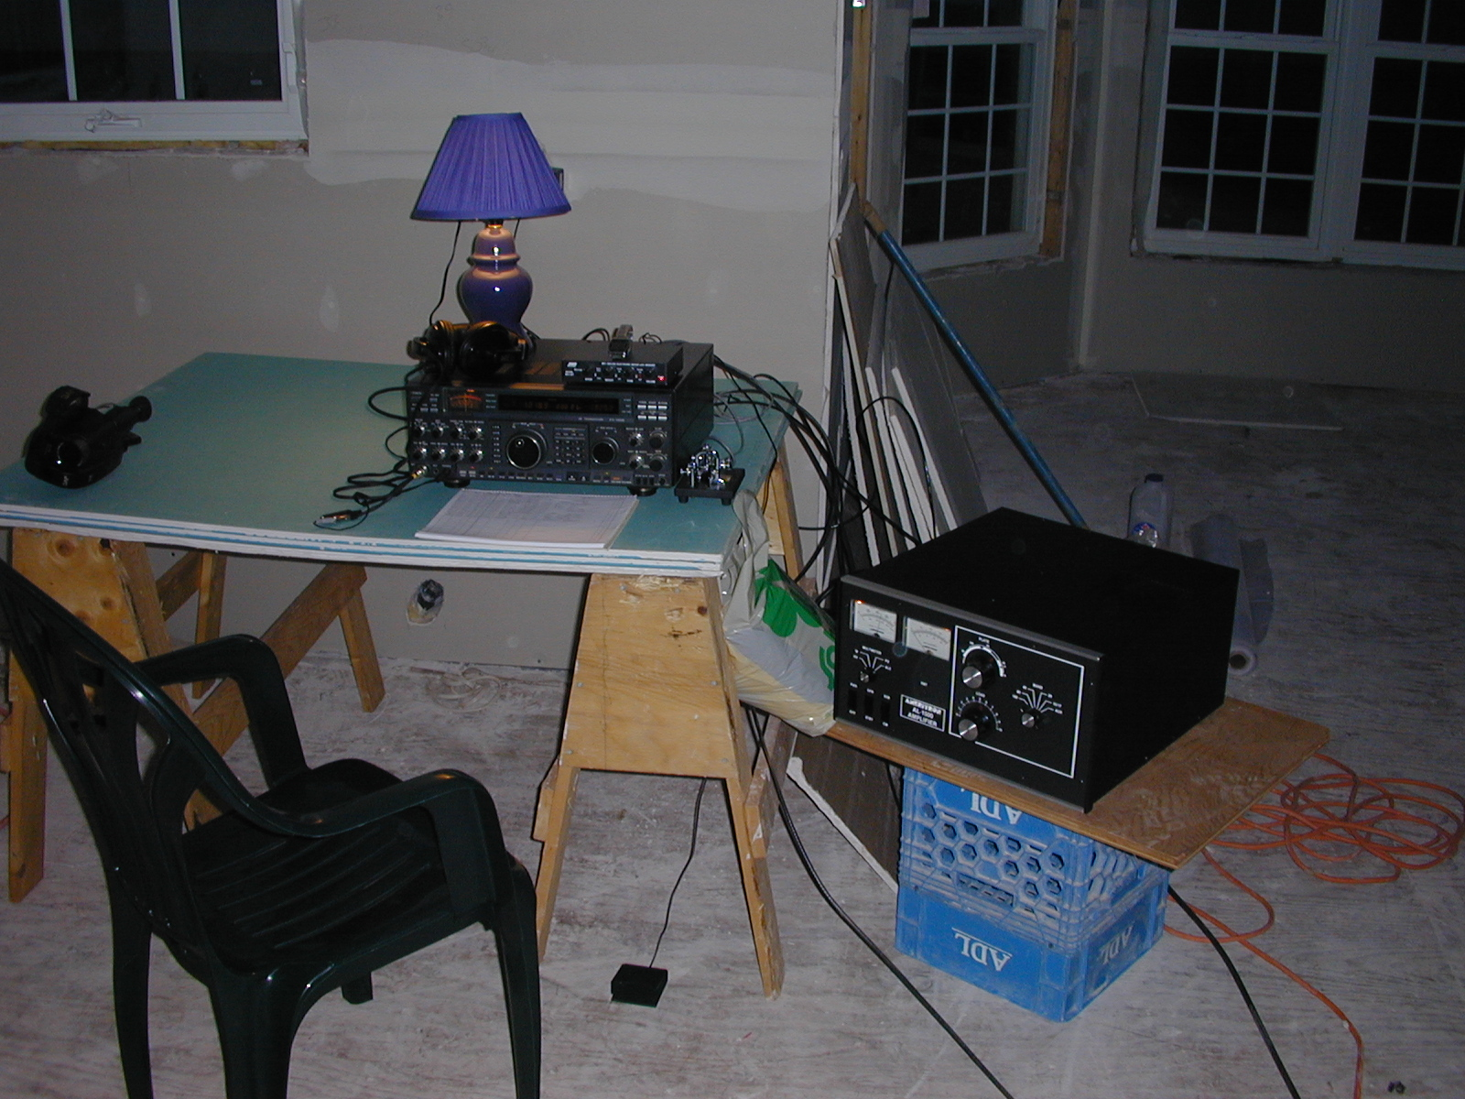
Testing 160M Antenna at Night
August 2001

Slide 8
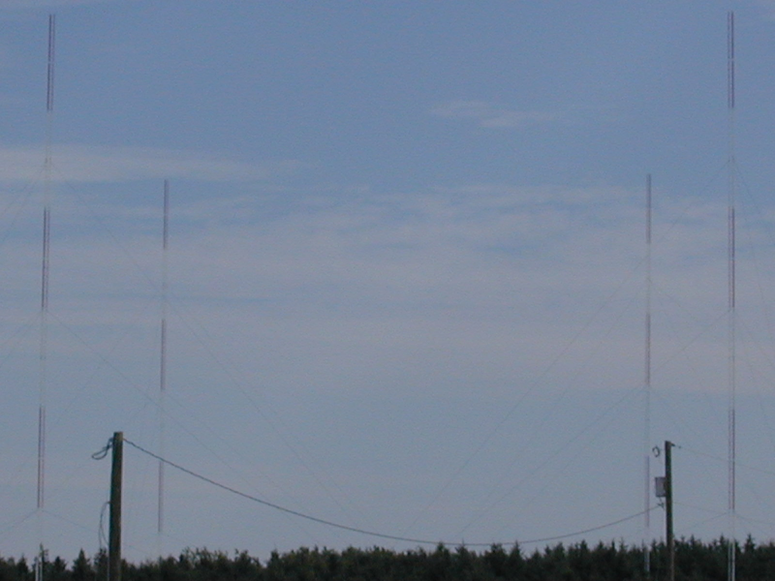
160M 2 x 2 BS/EF Array

Slide 9
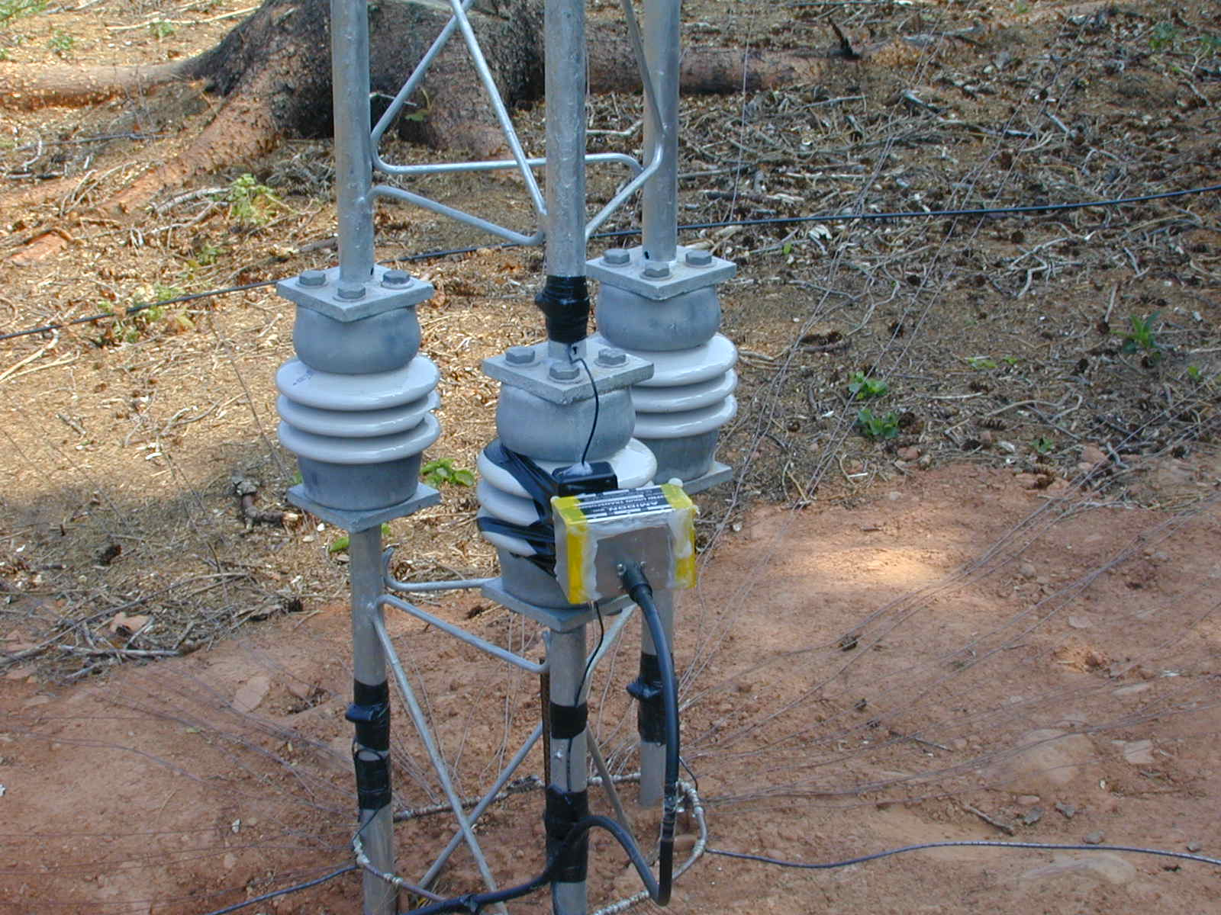
Rohn 160m Vertical Insulated Base

Slide 10
160 Array Patterns
8db Unidirectional to EU – Phasing -90/0
8db Unidirectional to SW – Phasing 0/-90
5db Bidirectional NE/SW – Phasing -90/-90
3db Bidirectional NW/SE – Phasing -90/-180
Split Pattern N&E 6db – Phase -90/0/-180/-180
Split Pattern W &S 6db– Phase 0/-90/-180/-180

Slide 11
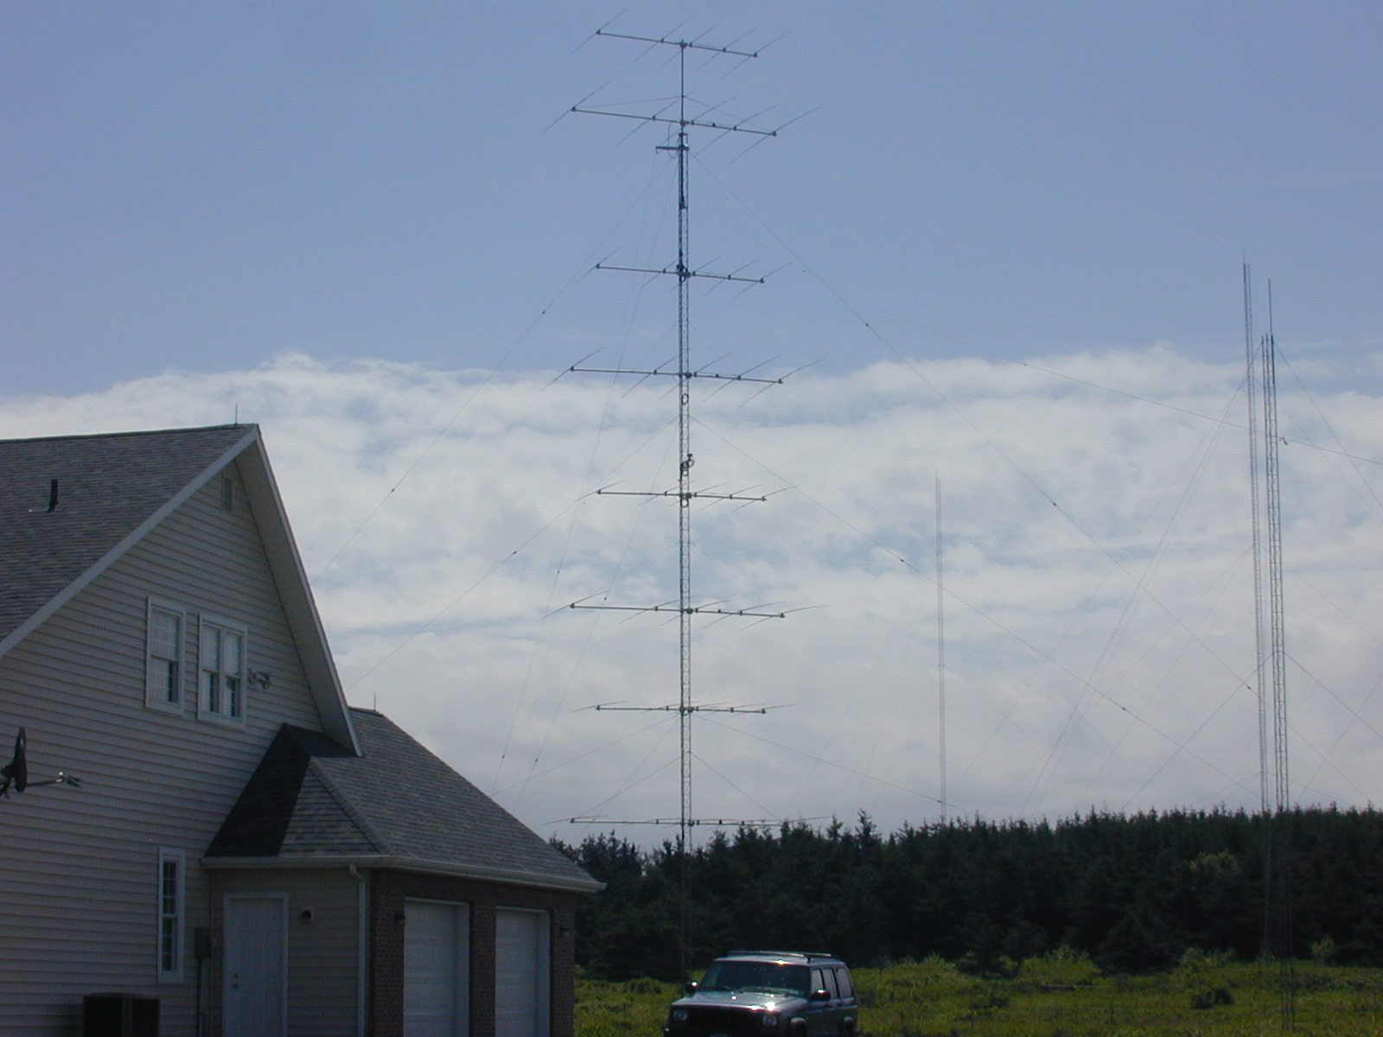
15M Quad Stacks & 80M 4SQ

Slide 12
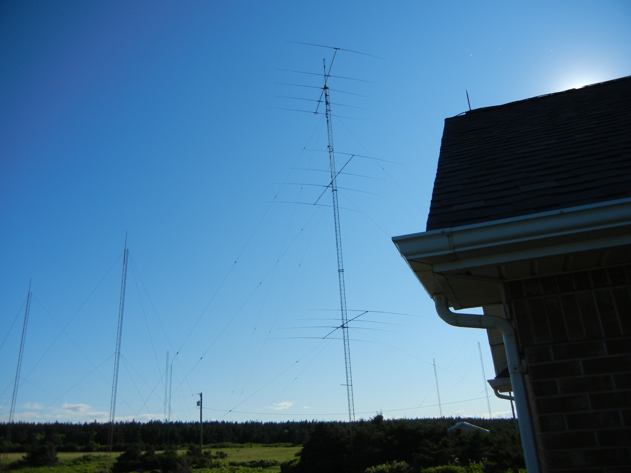
20M Stacks 130/80/40ft

Slide 13
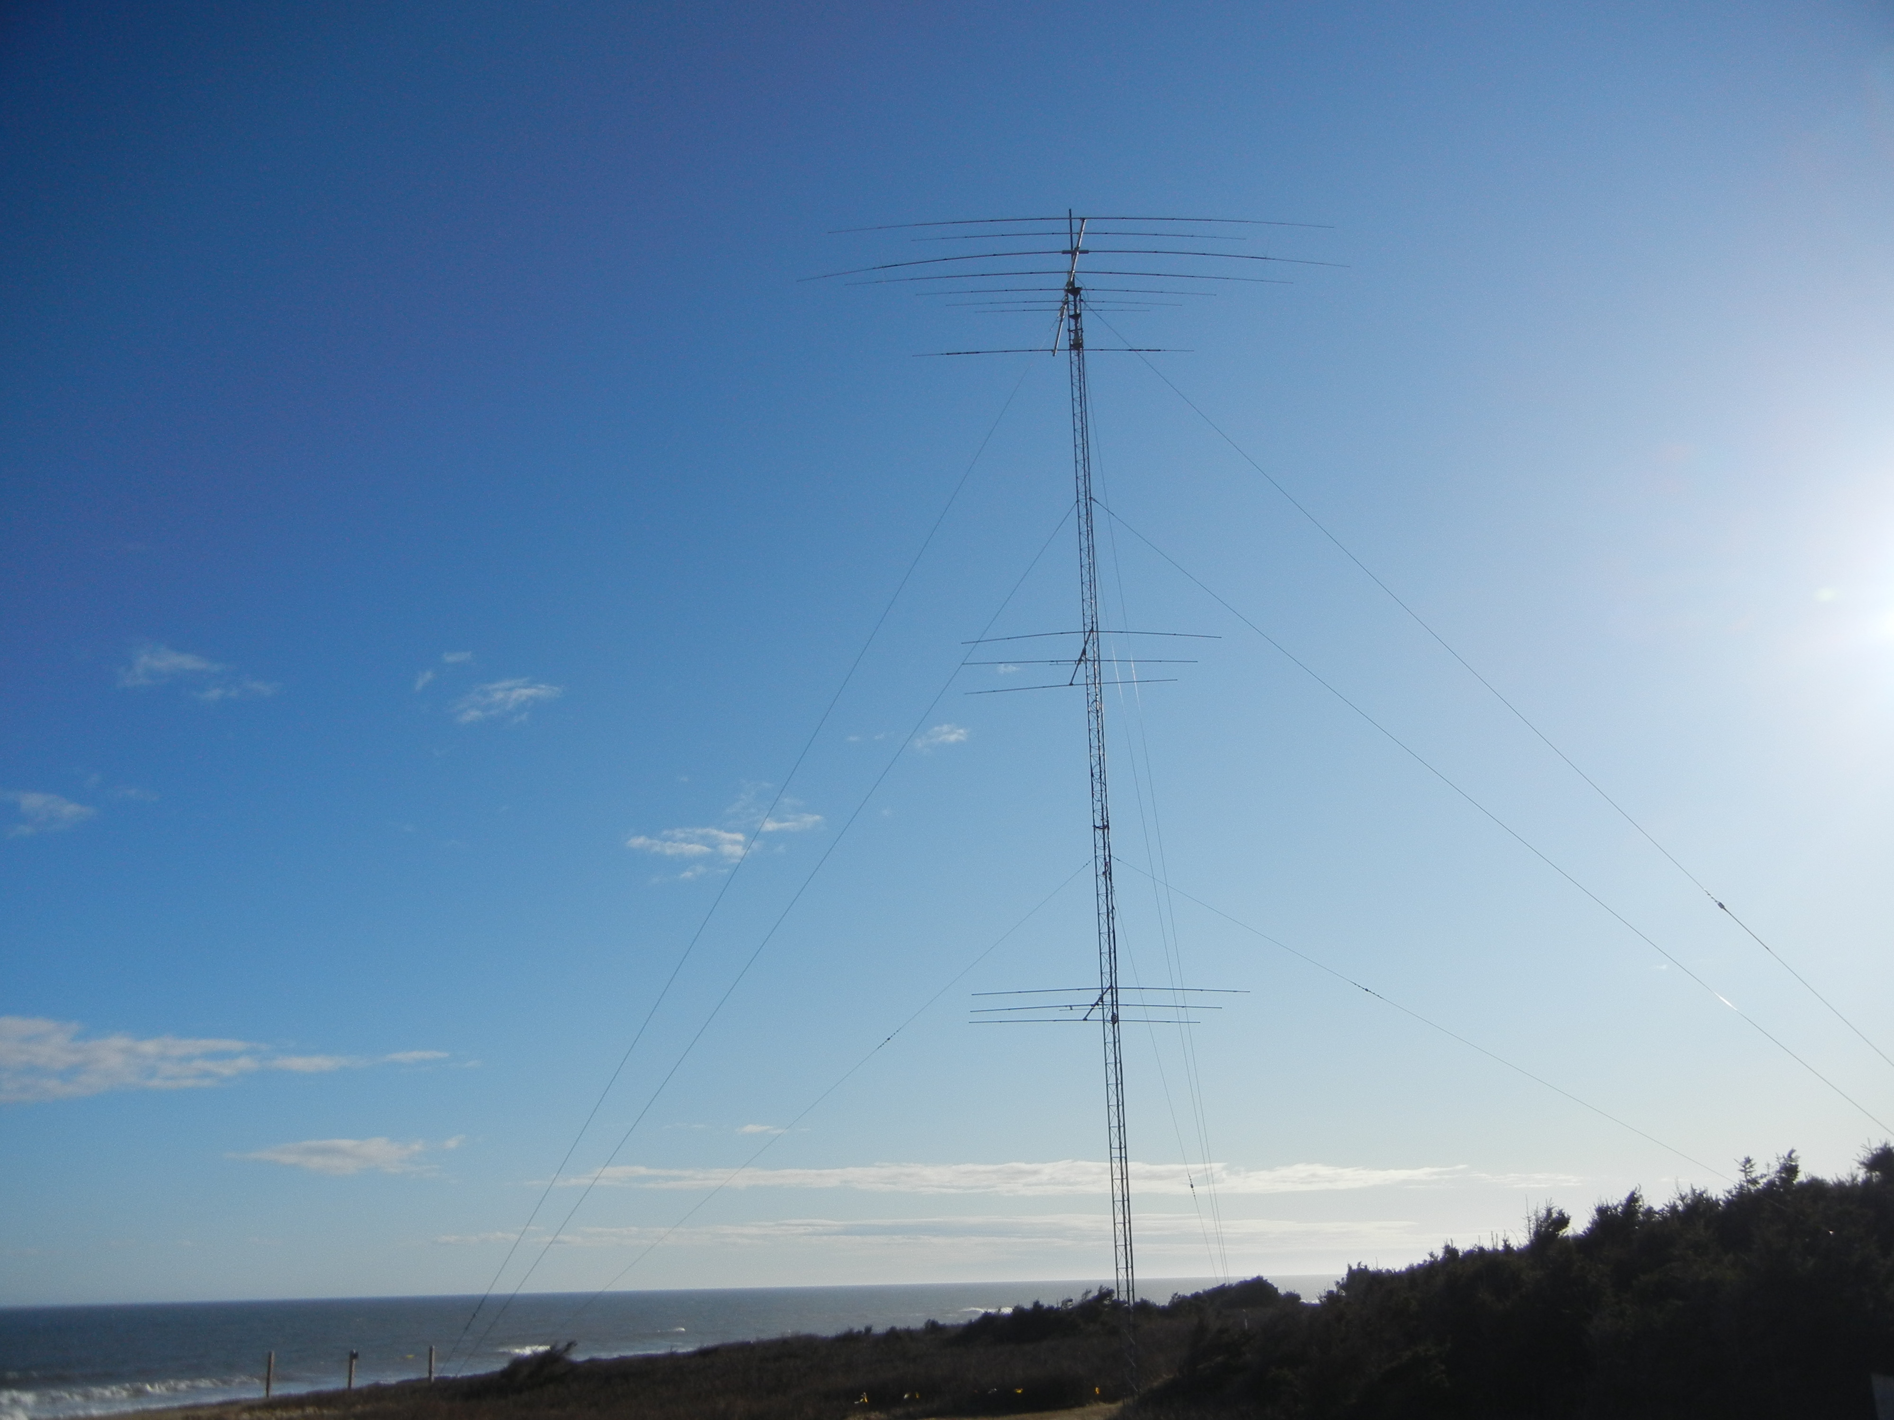
X7 Backup Tribander & 10M 3/3

Slide 14
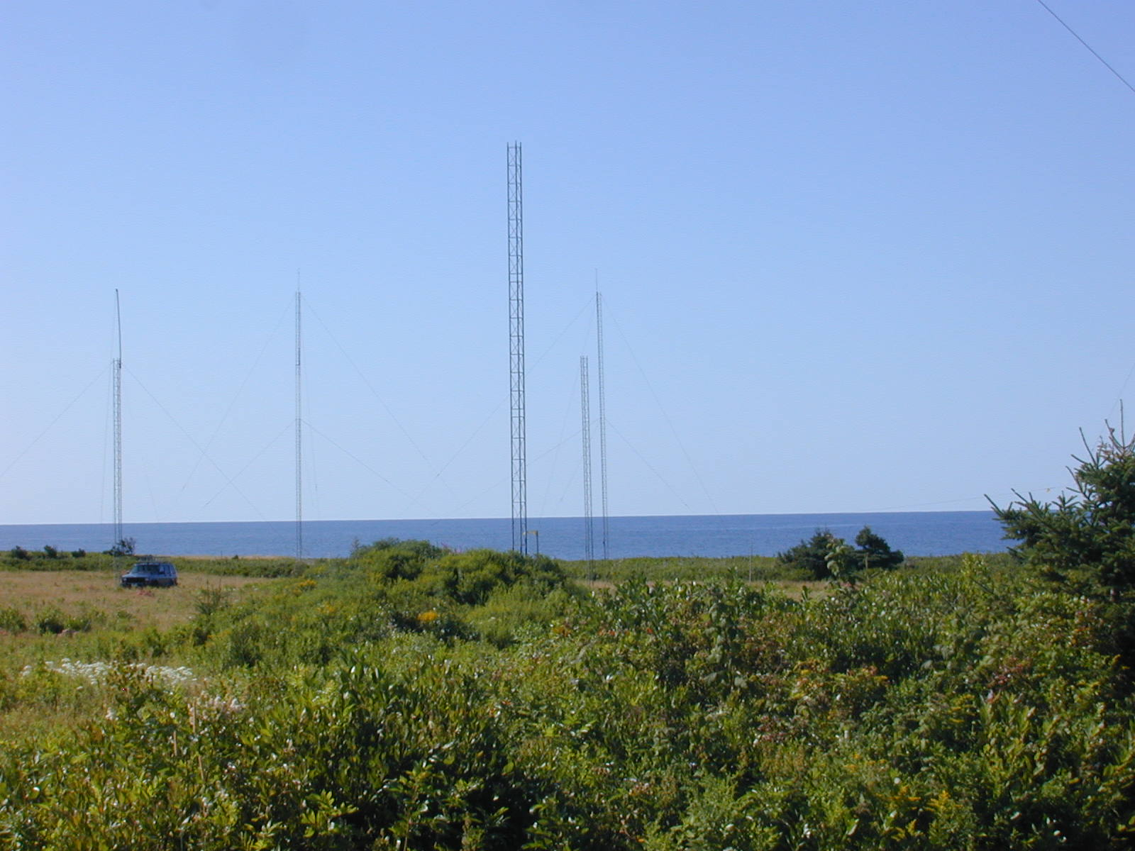
80M 3 x 3 BS/EF Array in Progress

Slide 15
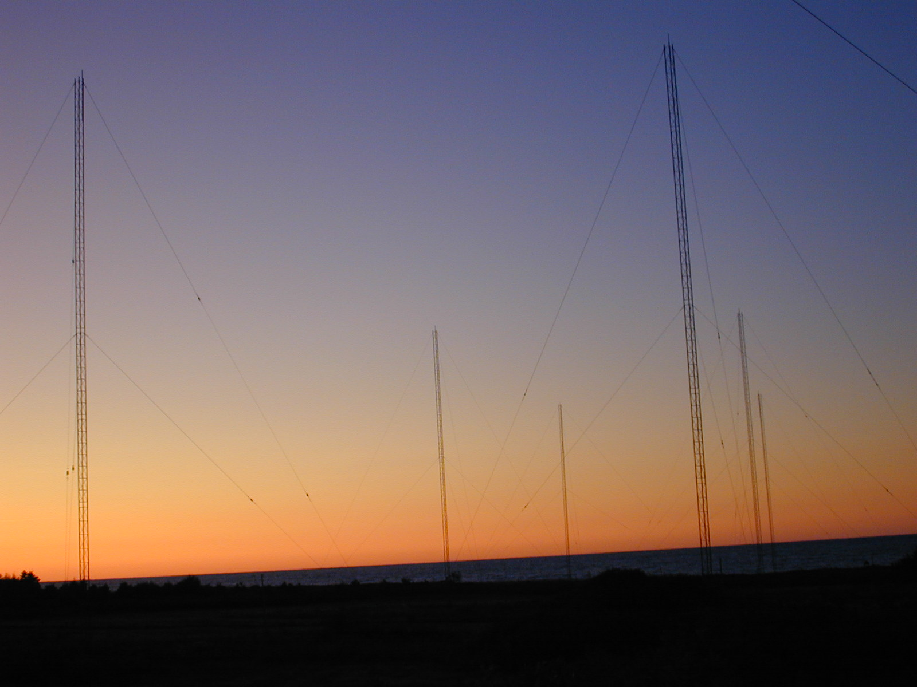
80m Array at Sunset

Slide 16
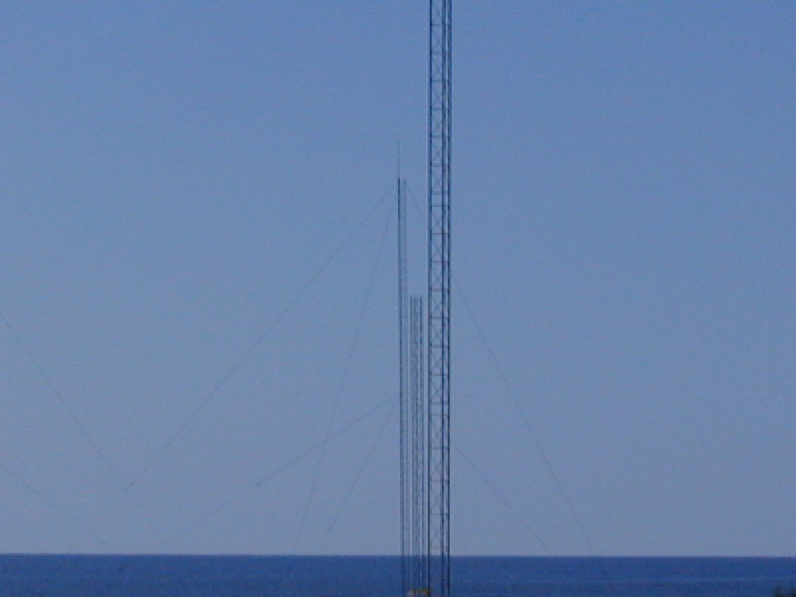
80M (3) in Line – NE Side of Array

Slide 17
80M 3x3 Eznec Plot

Slide 18
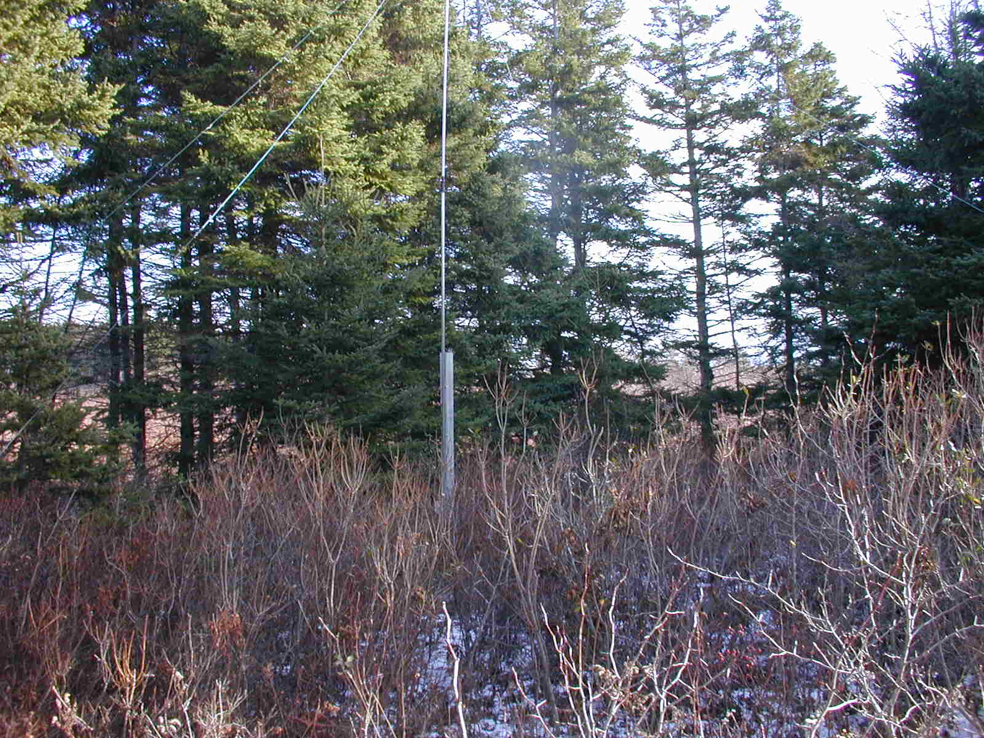
One of (6) Rx Short Verts for 160M

Slide 19
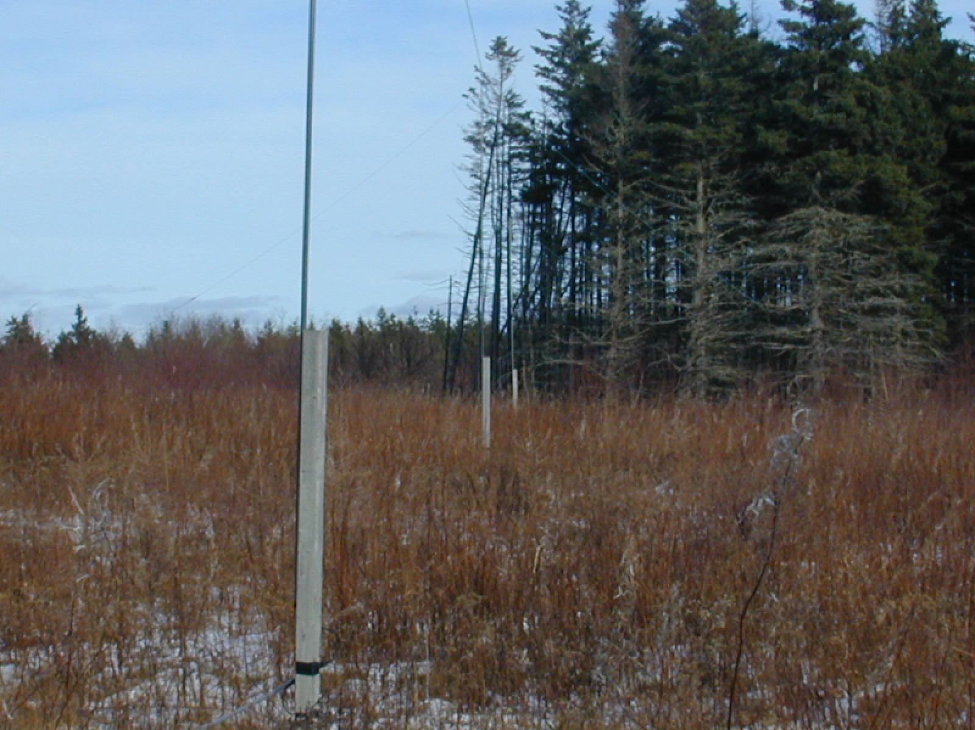
Three 160M Rx Verticals in Line

Slide 20
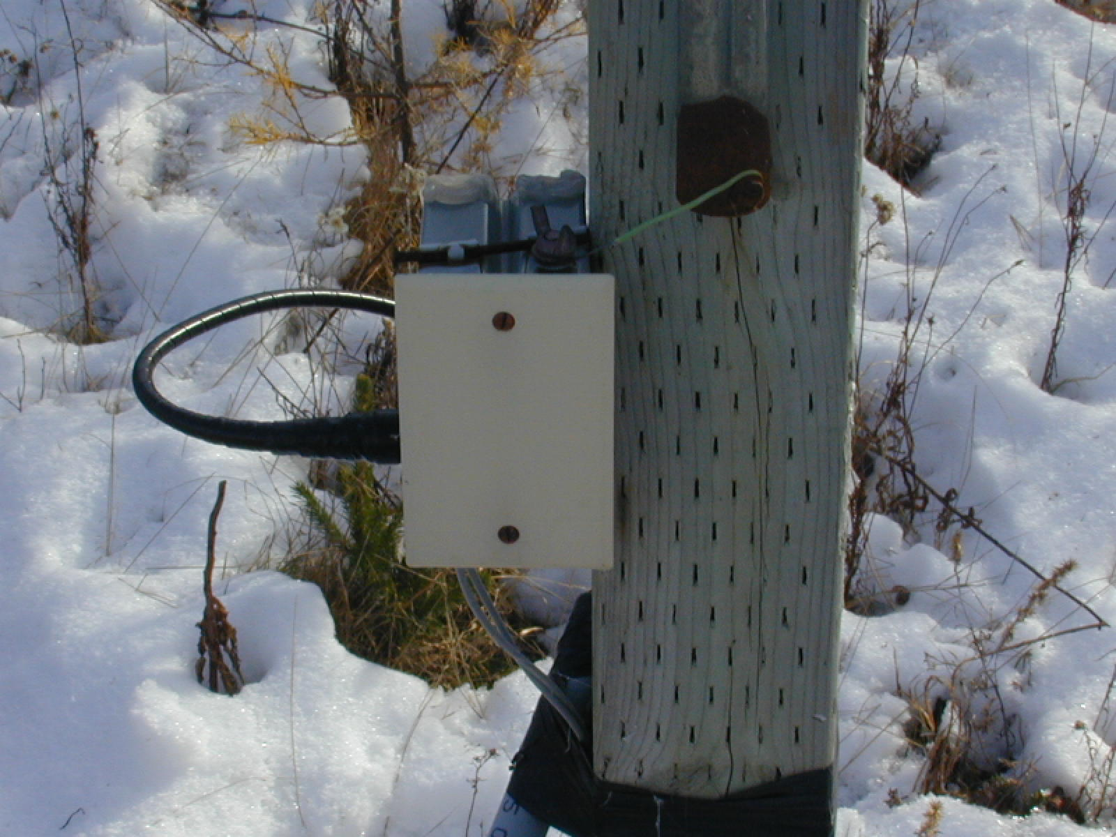
Feed/Matching System for RX Ants

Slide 21
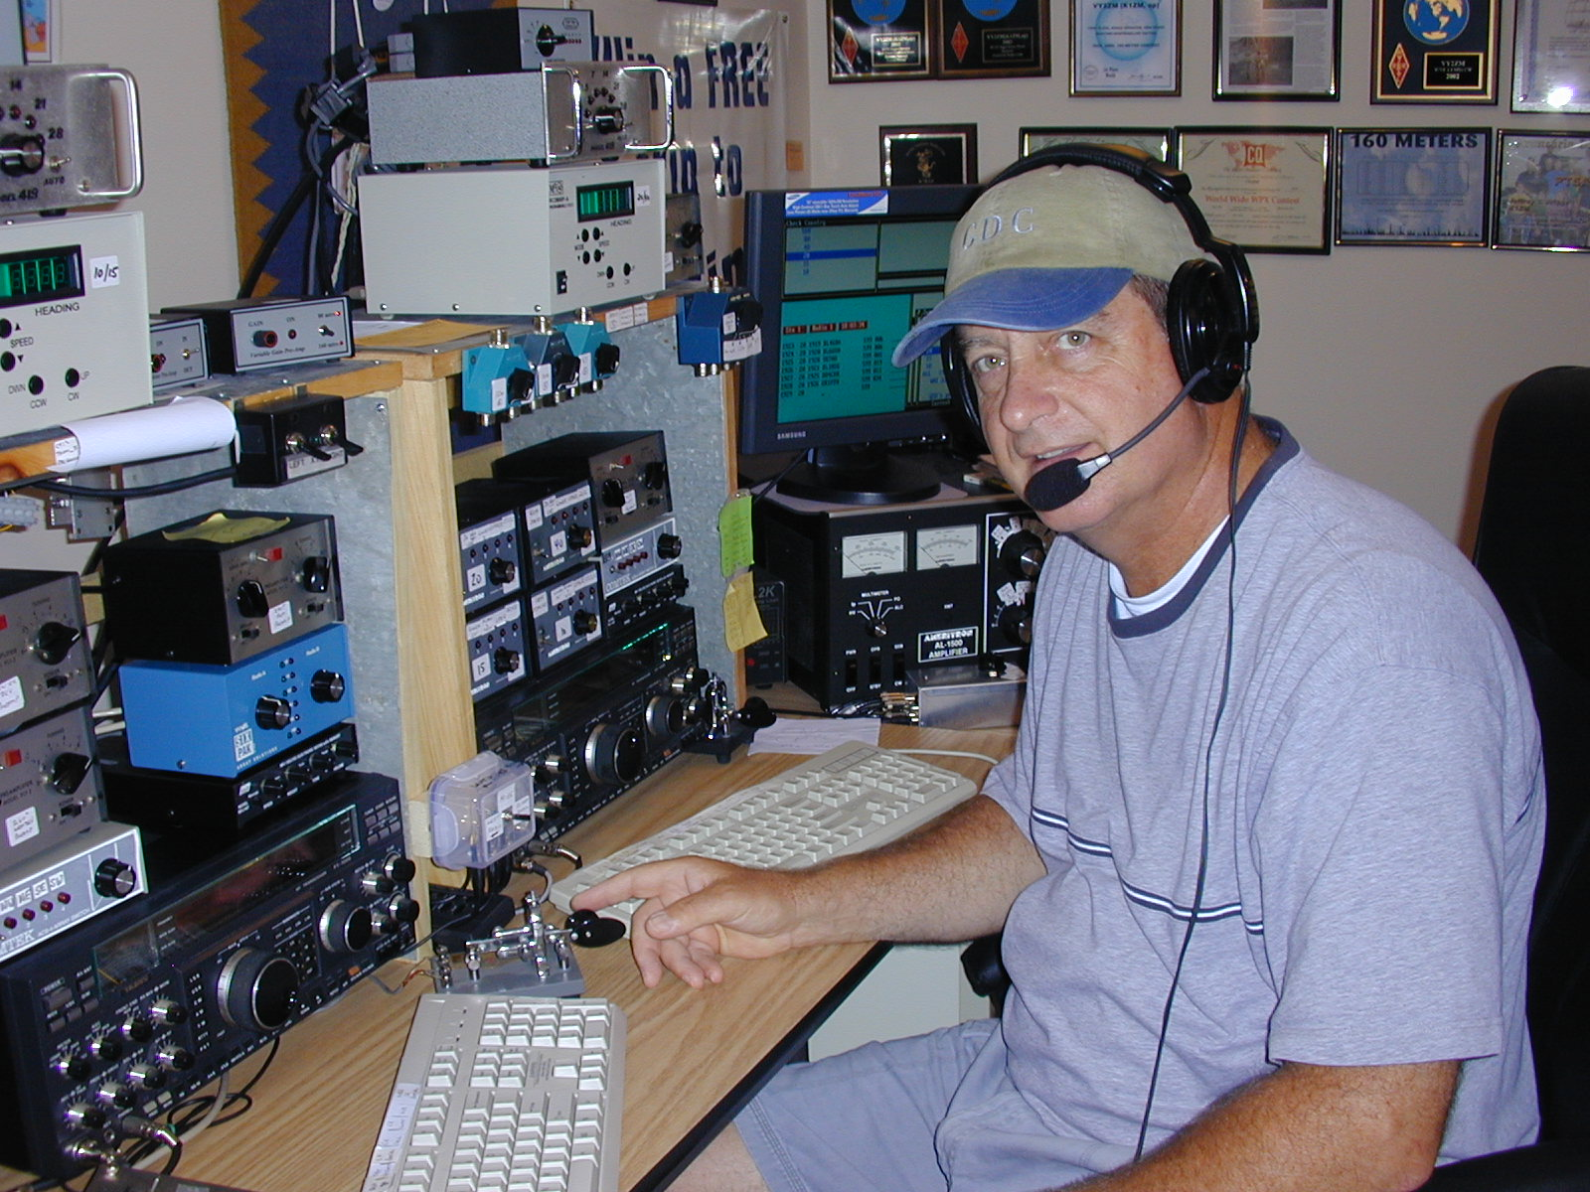
Inside the VY2ZM Station

Slide 22
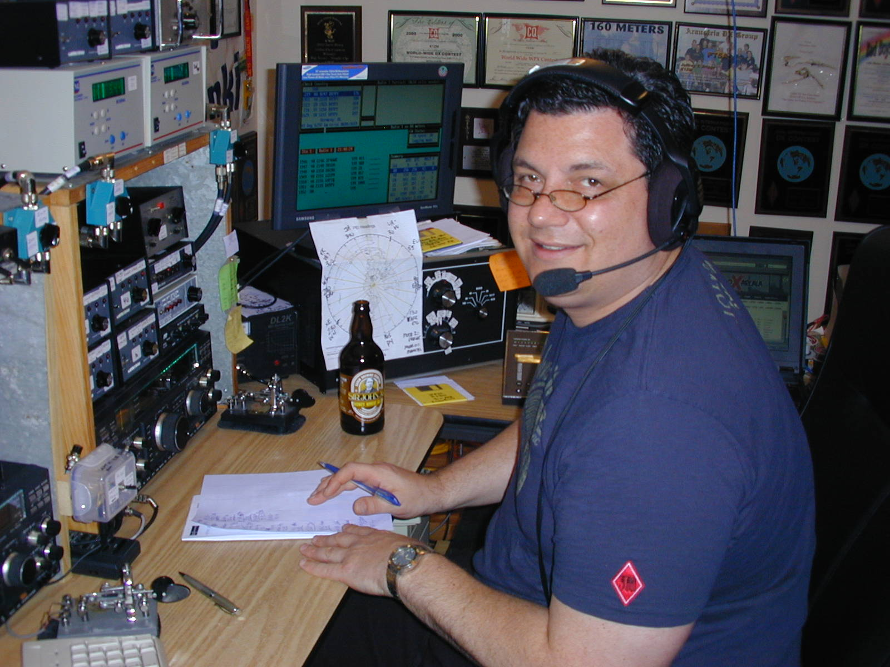
My Son Patrick KK6ZM (K6AAX)

Slide 23
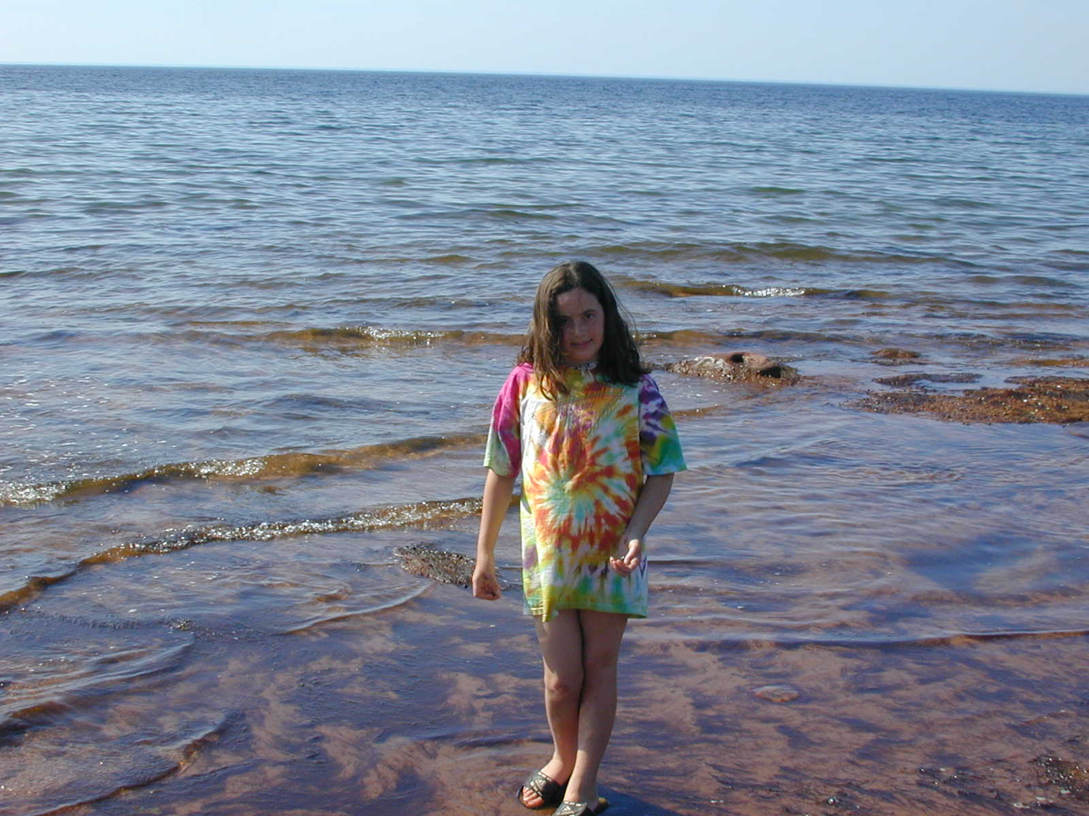
Daughter Lucy on Our Beach – Water is +20C in July/August

Slide 24
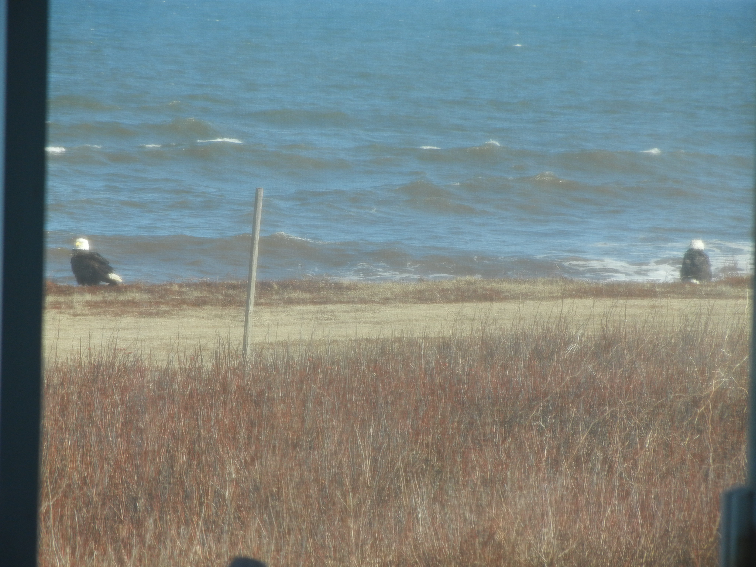
Bald Eagles at Our Shoreline

Slide 25
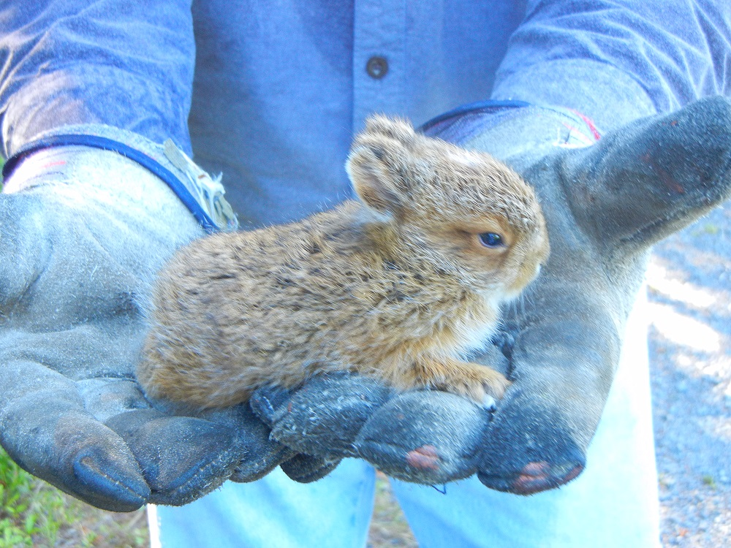
One of our Many Rabbits

Slide 26
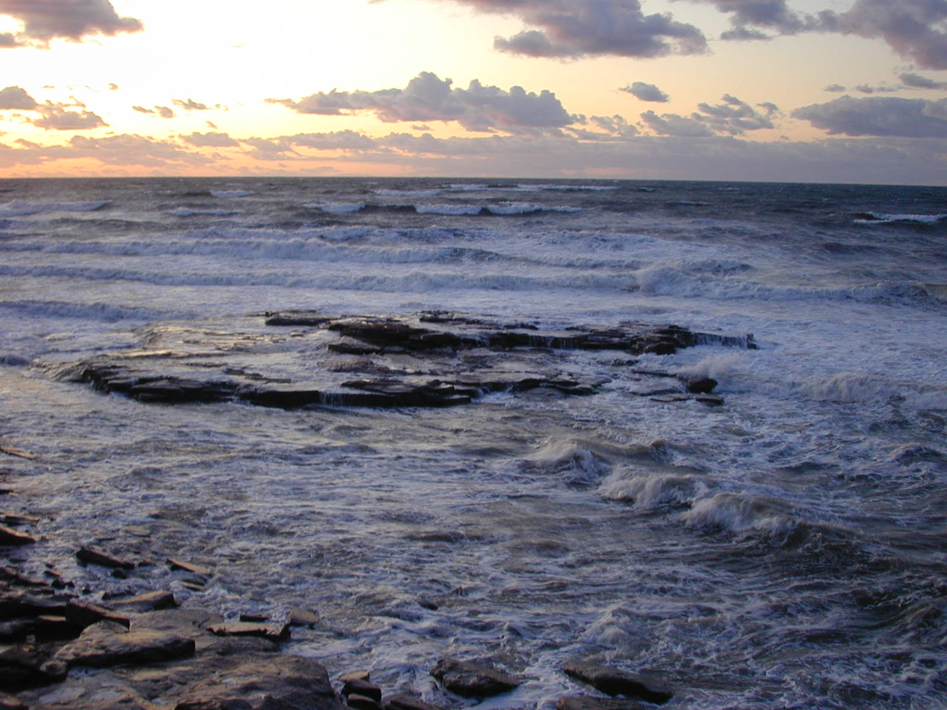
Crashing Surf at Sunset

Slide 27
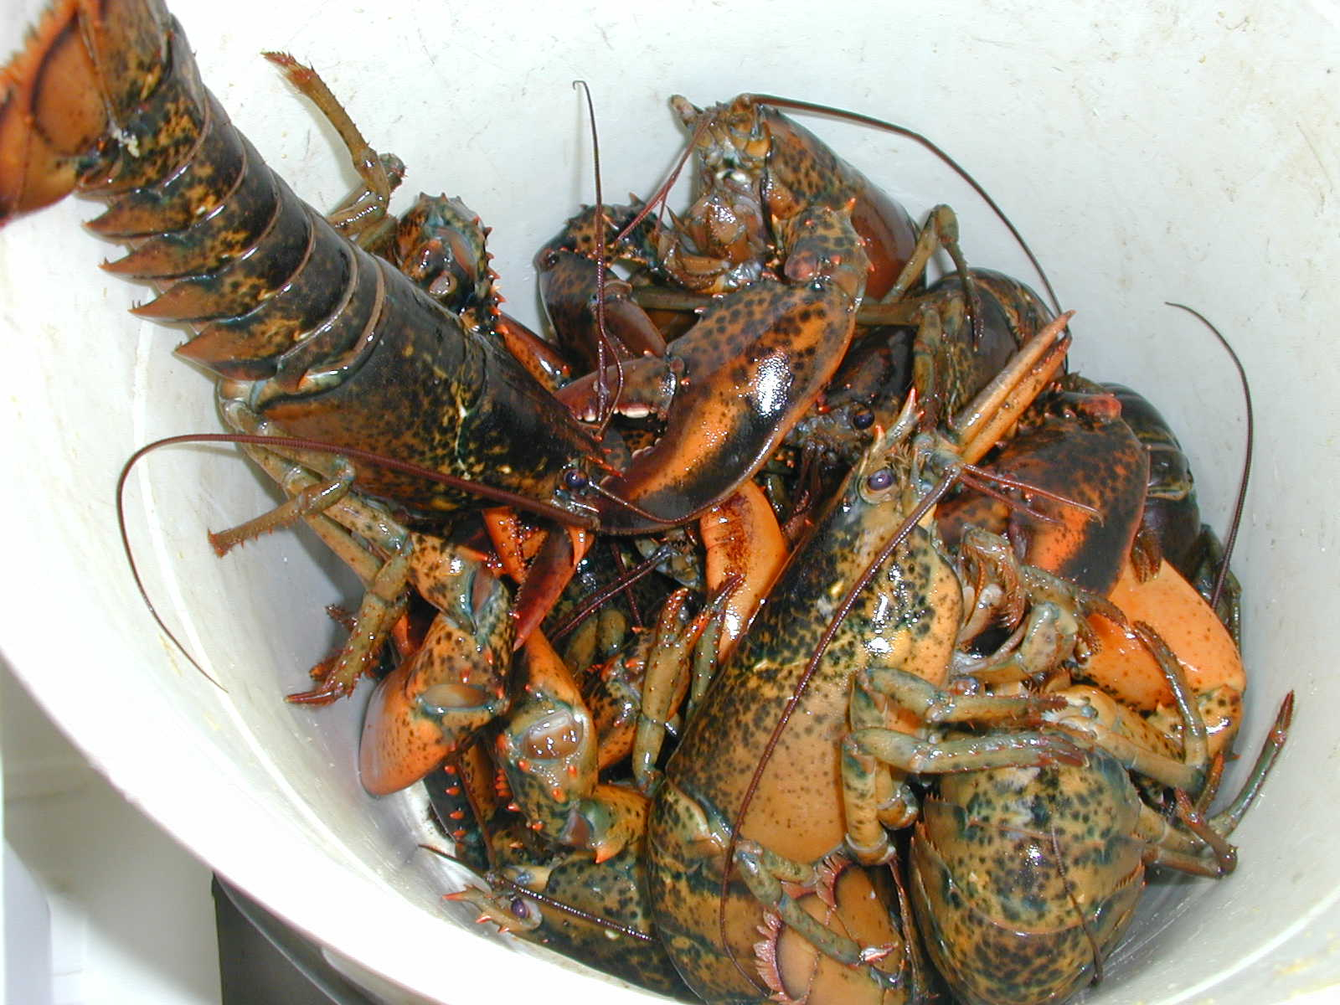
Lobsters Caught Behind our House

Slide 28
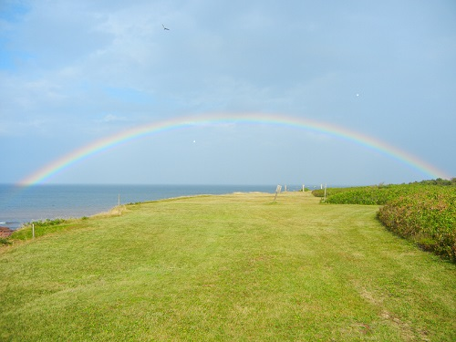
Rainbow Near Sunset

Slide 29
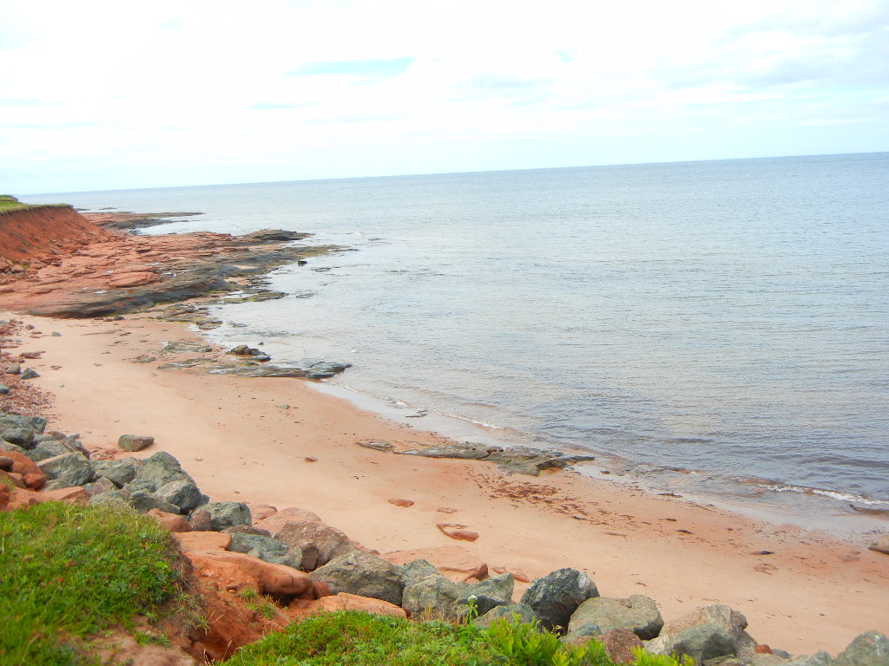
Beach Shoreline Behind the House

Slide 30
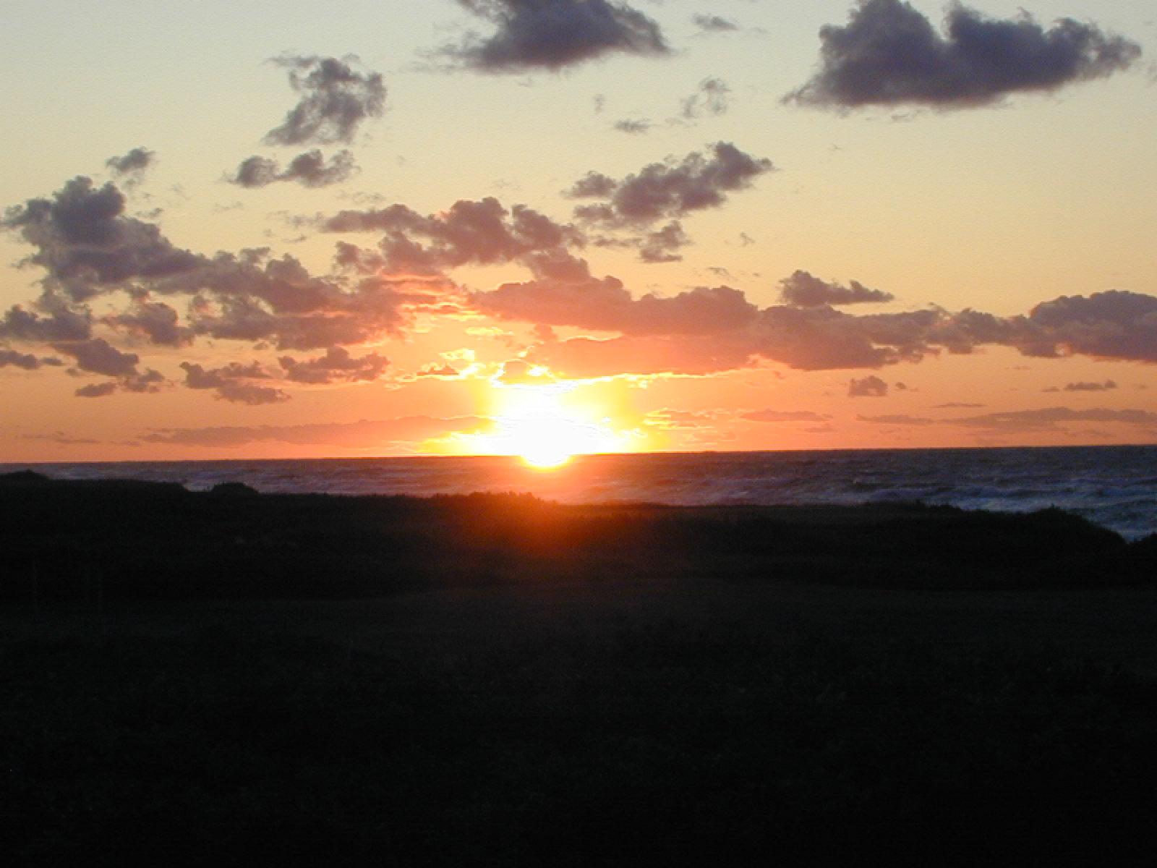
A Typical Sunset to the NW

Slide 31
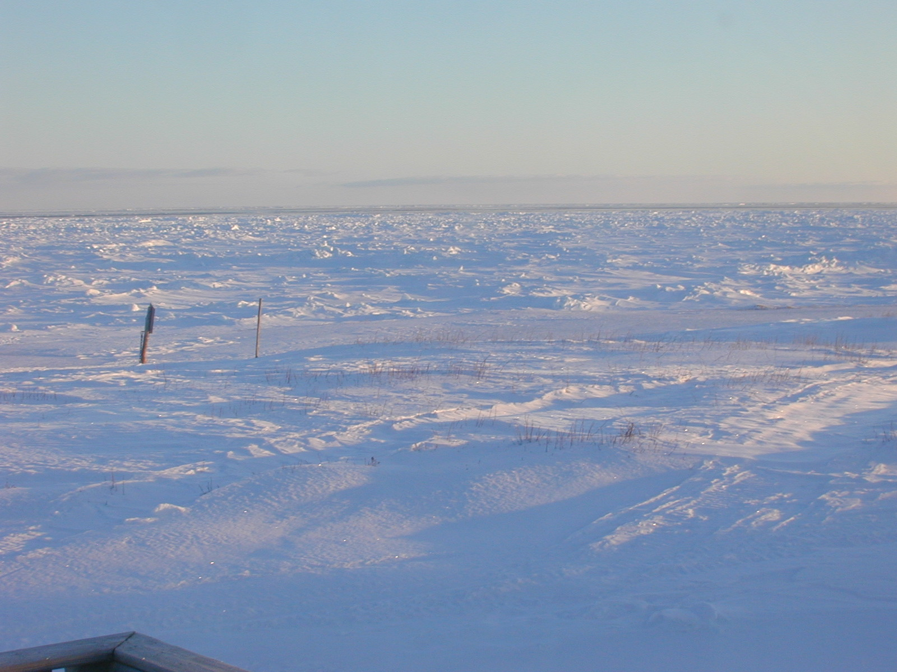
Land Meets Frozen Ocean

Slide 32
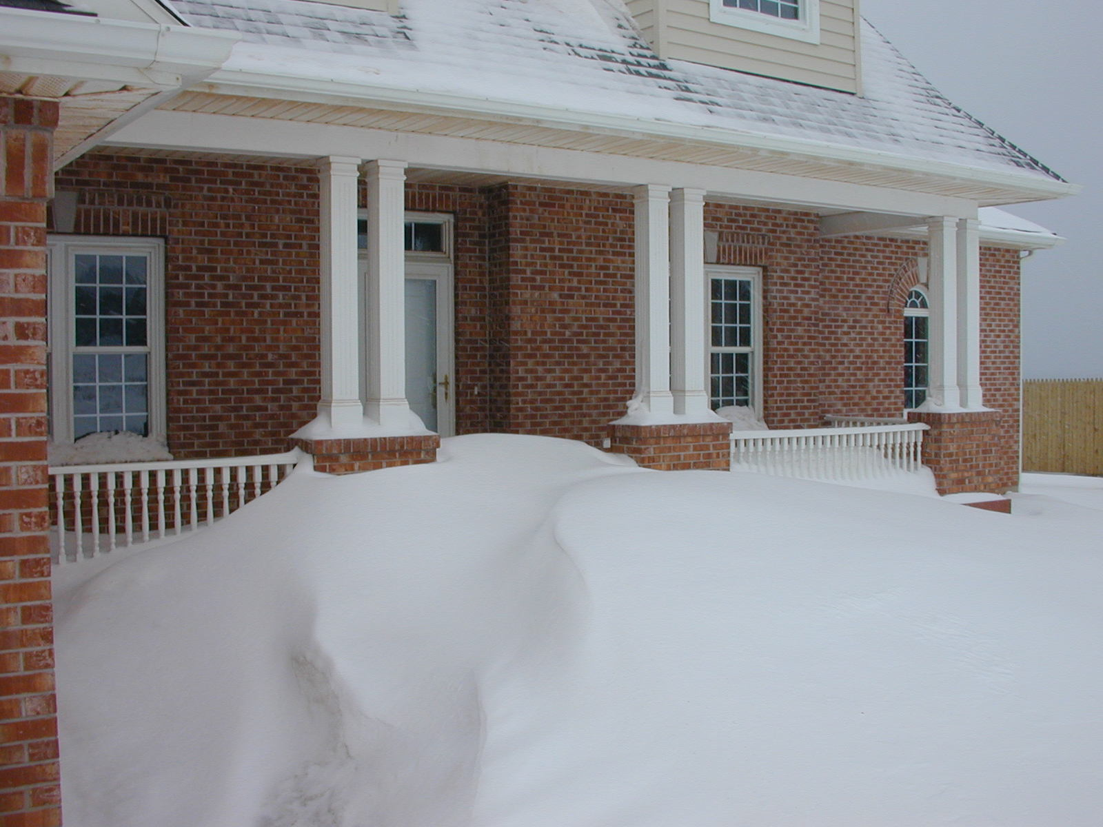
We Do Get Snows in Winter!

Slide 33
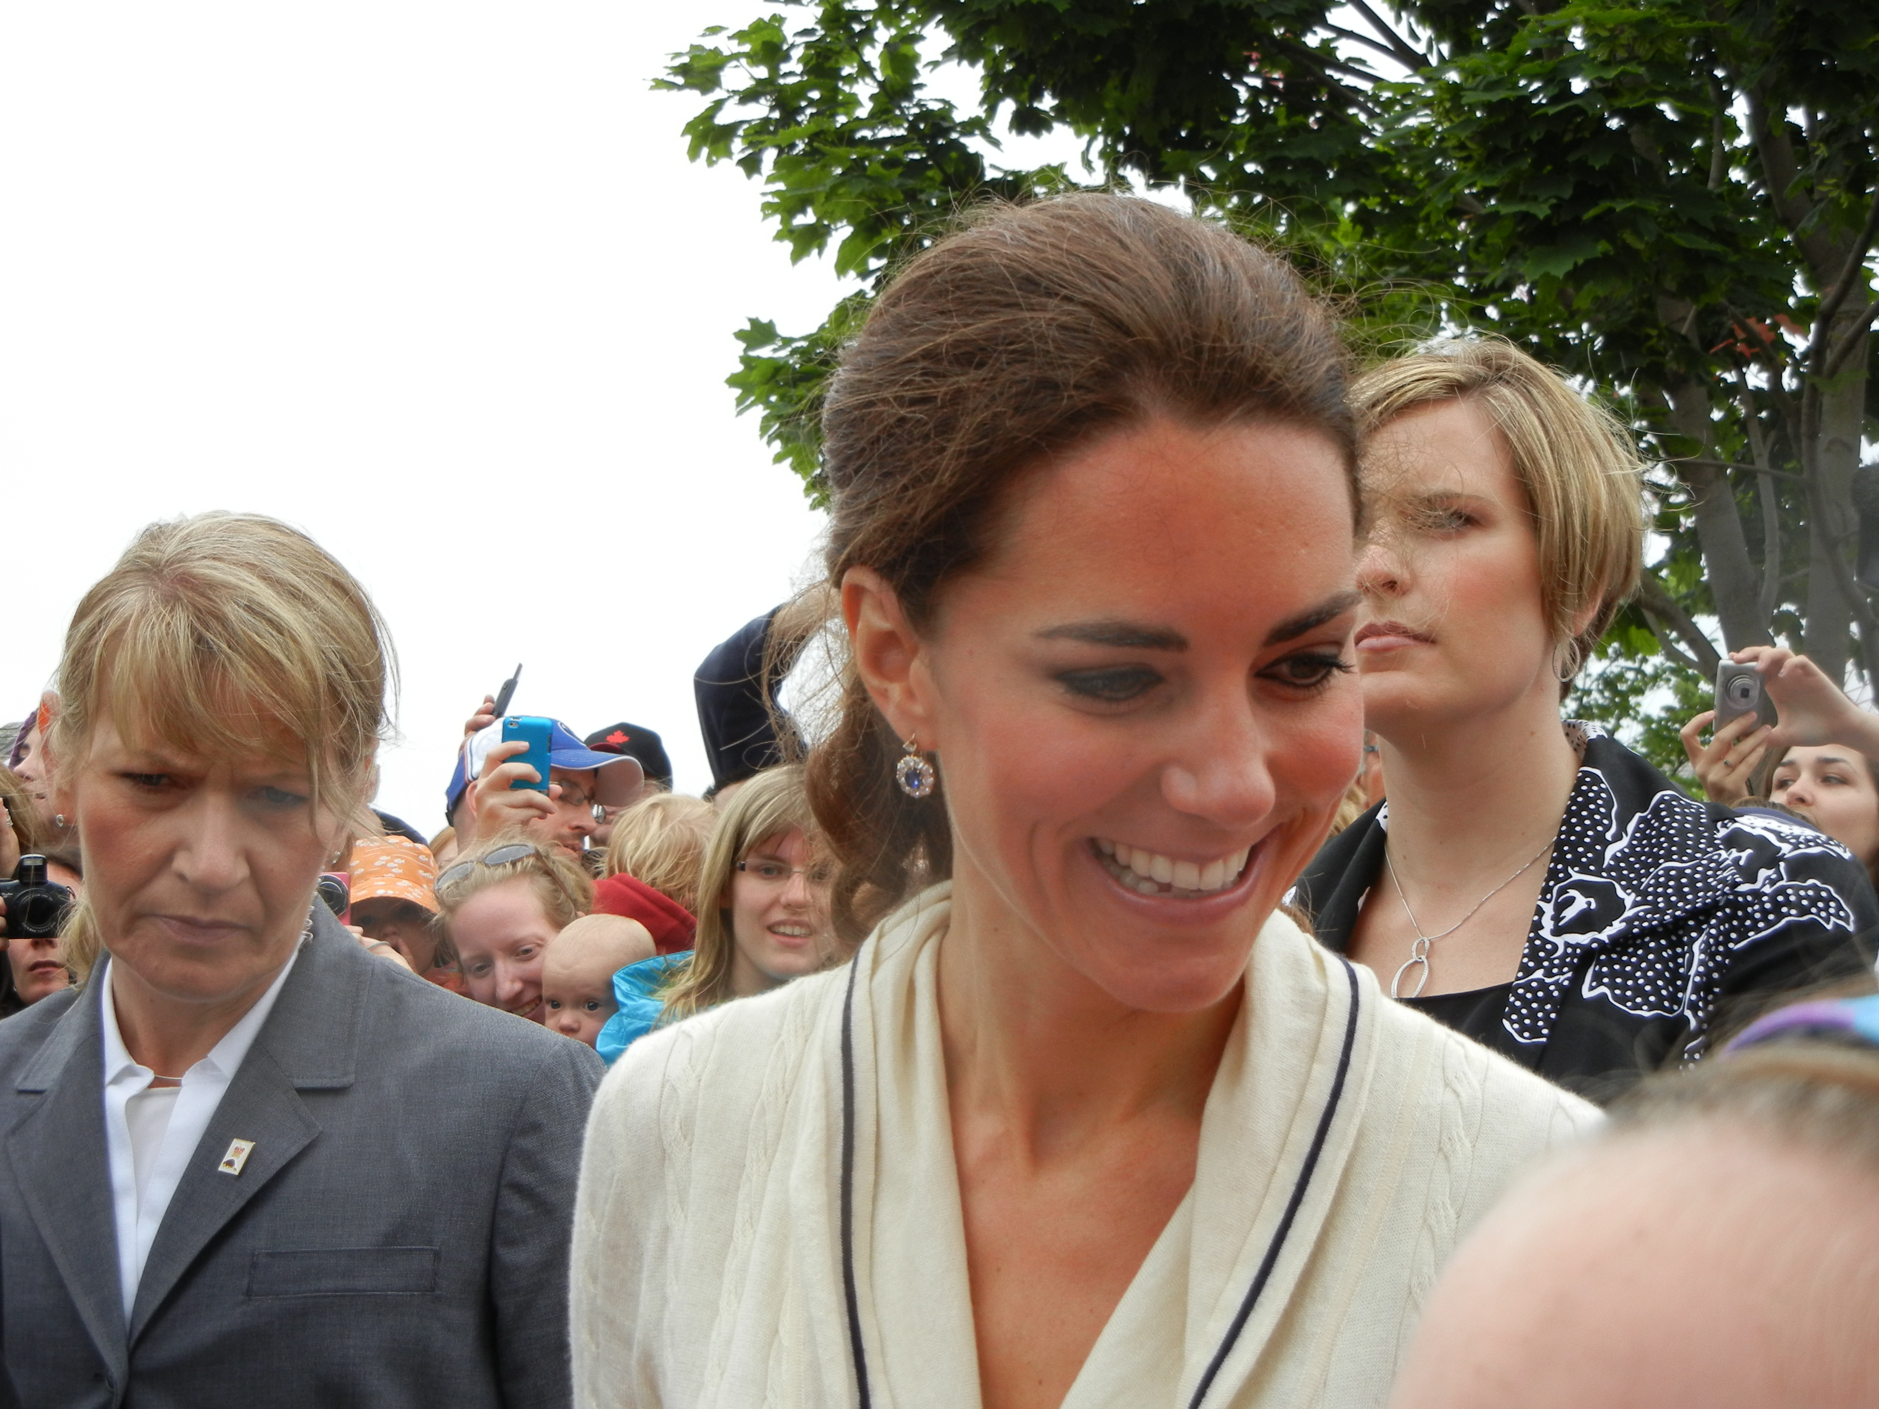
We Also Get Visitors in Summer!

Slide 34
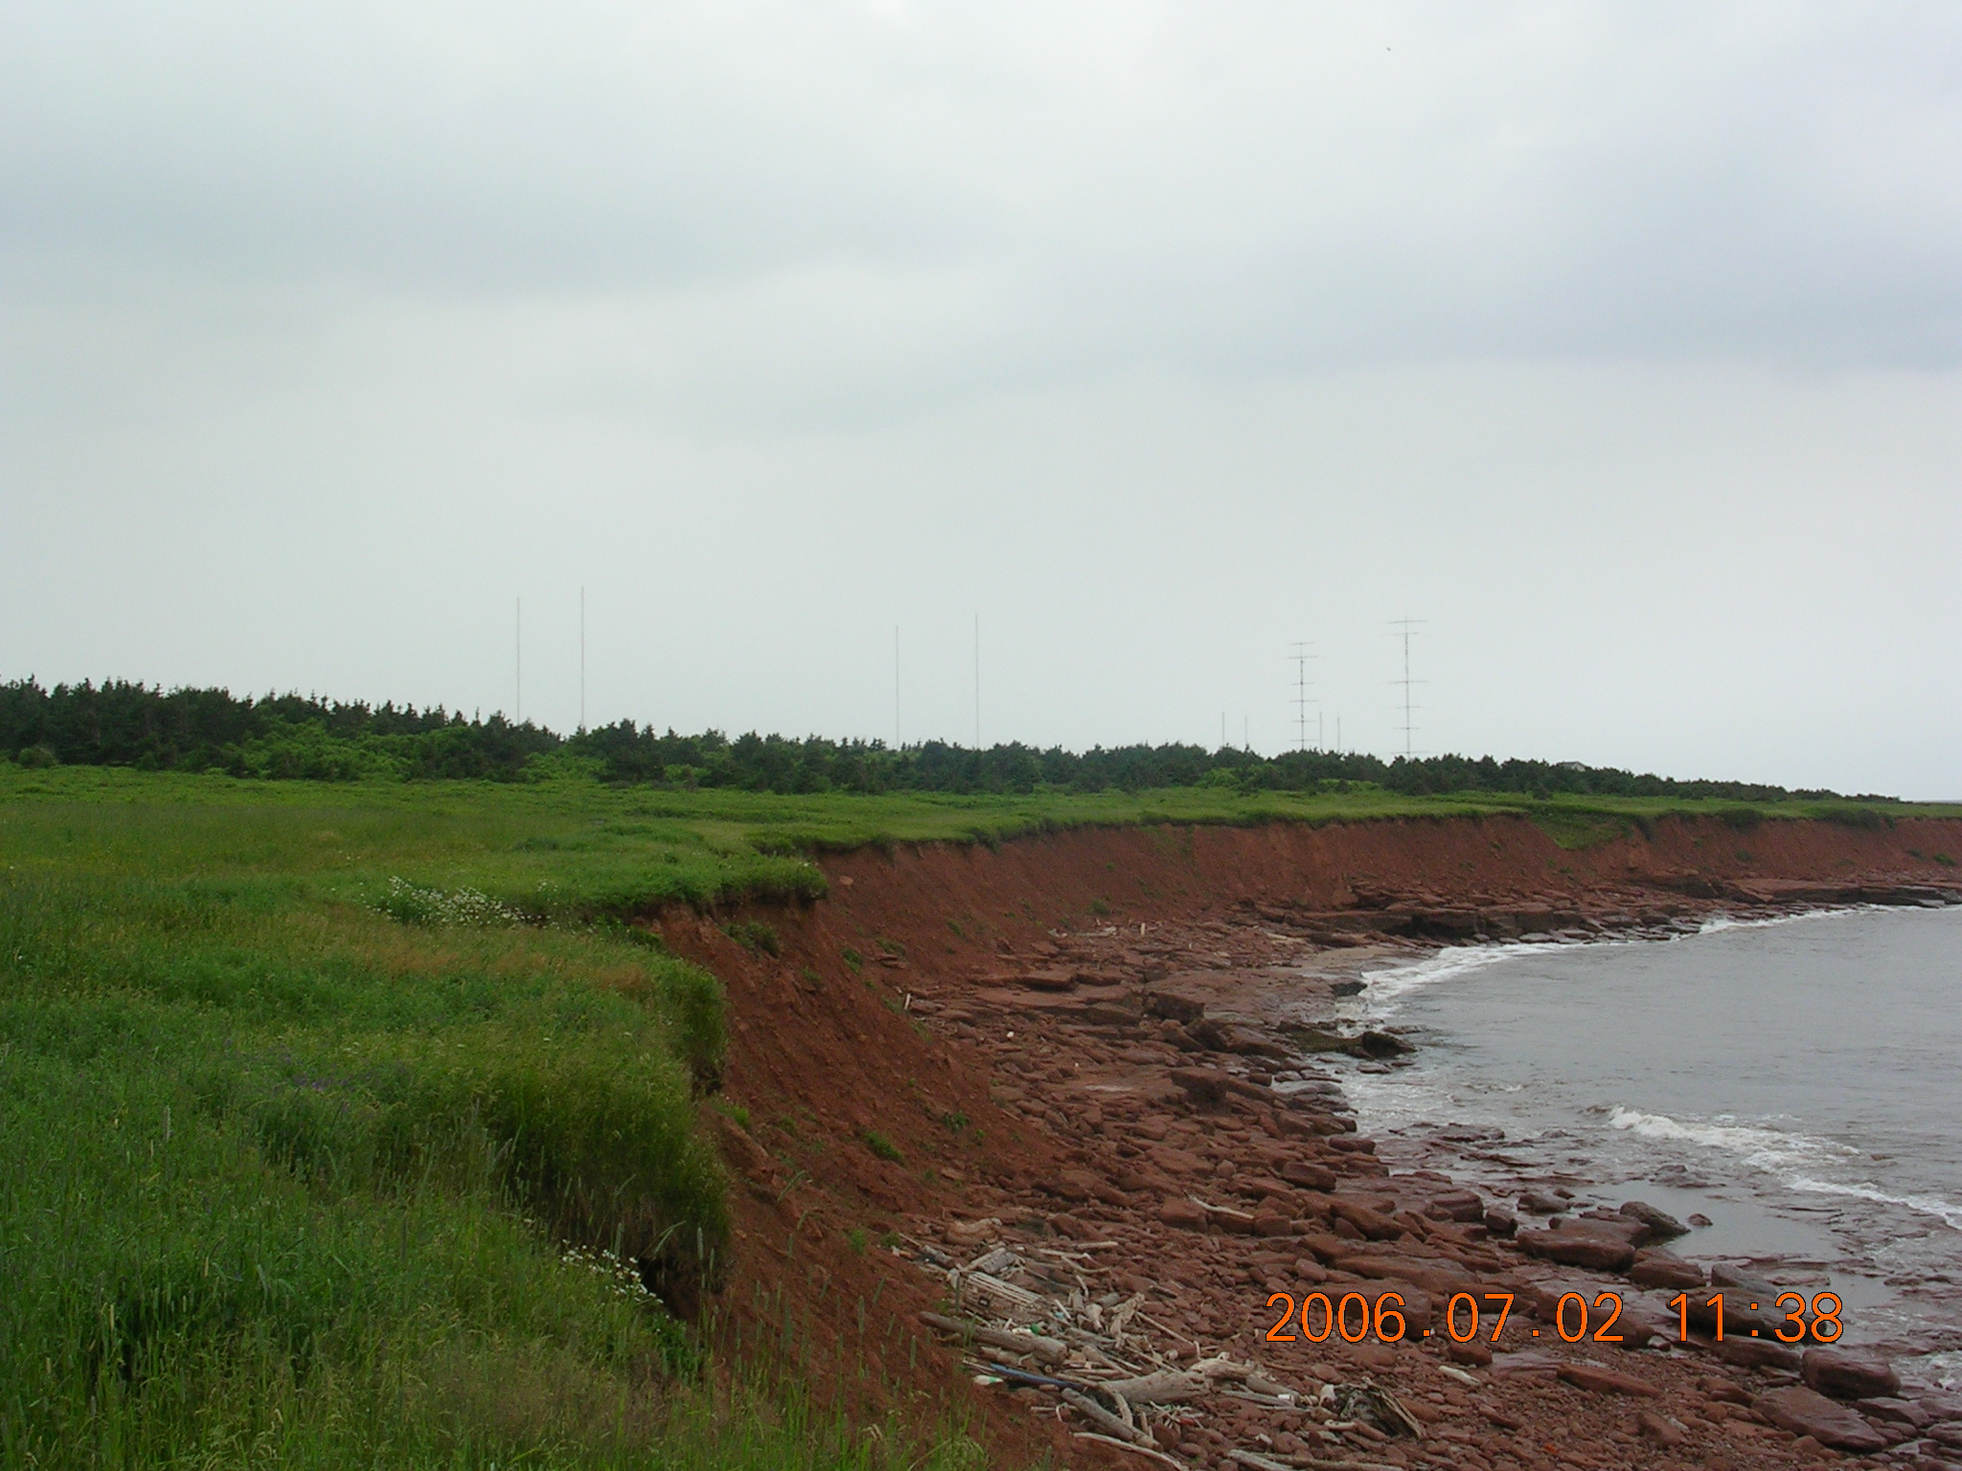
Westerly View from Nearest Neighbor's Homesite

Slide 35
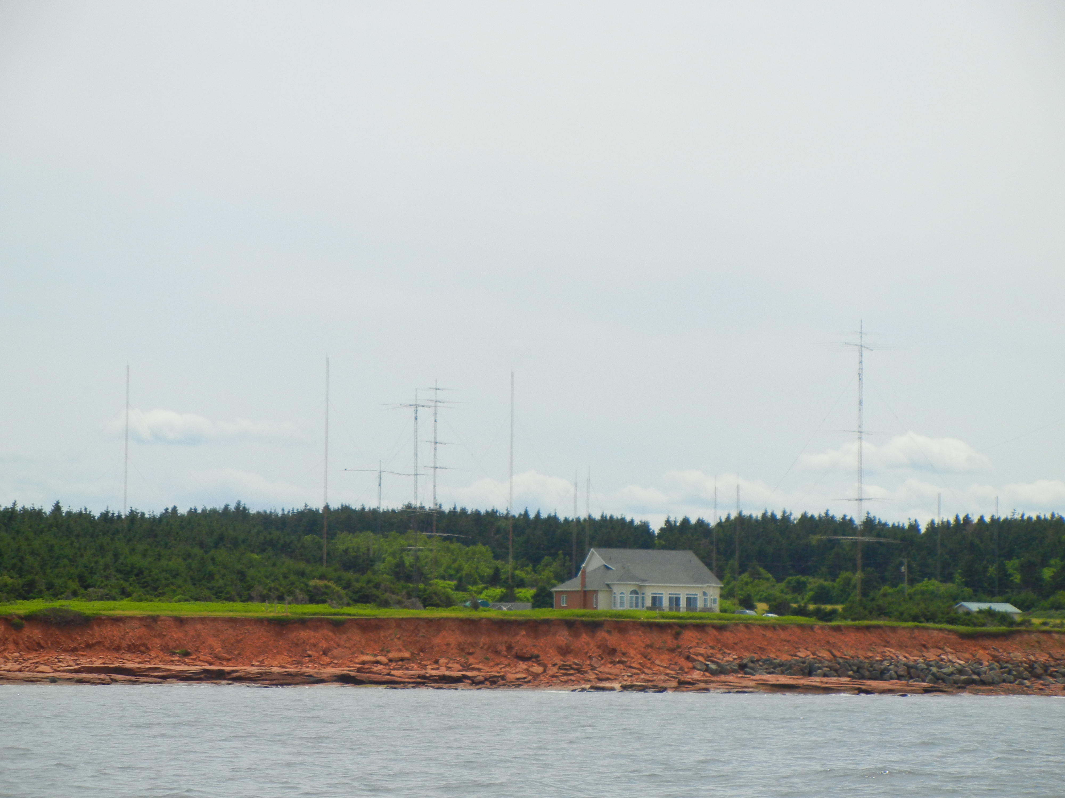
VY2ZM Viewed from Offshore

Slide 36
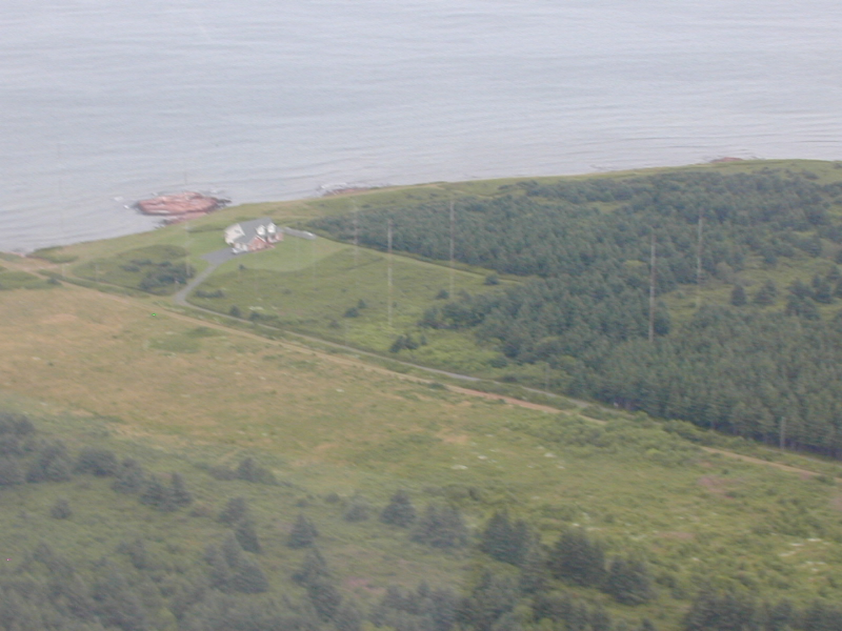
Aerial View 2005 from KD4D's Plane

Slide 37
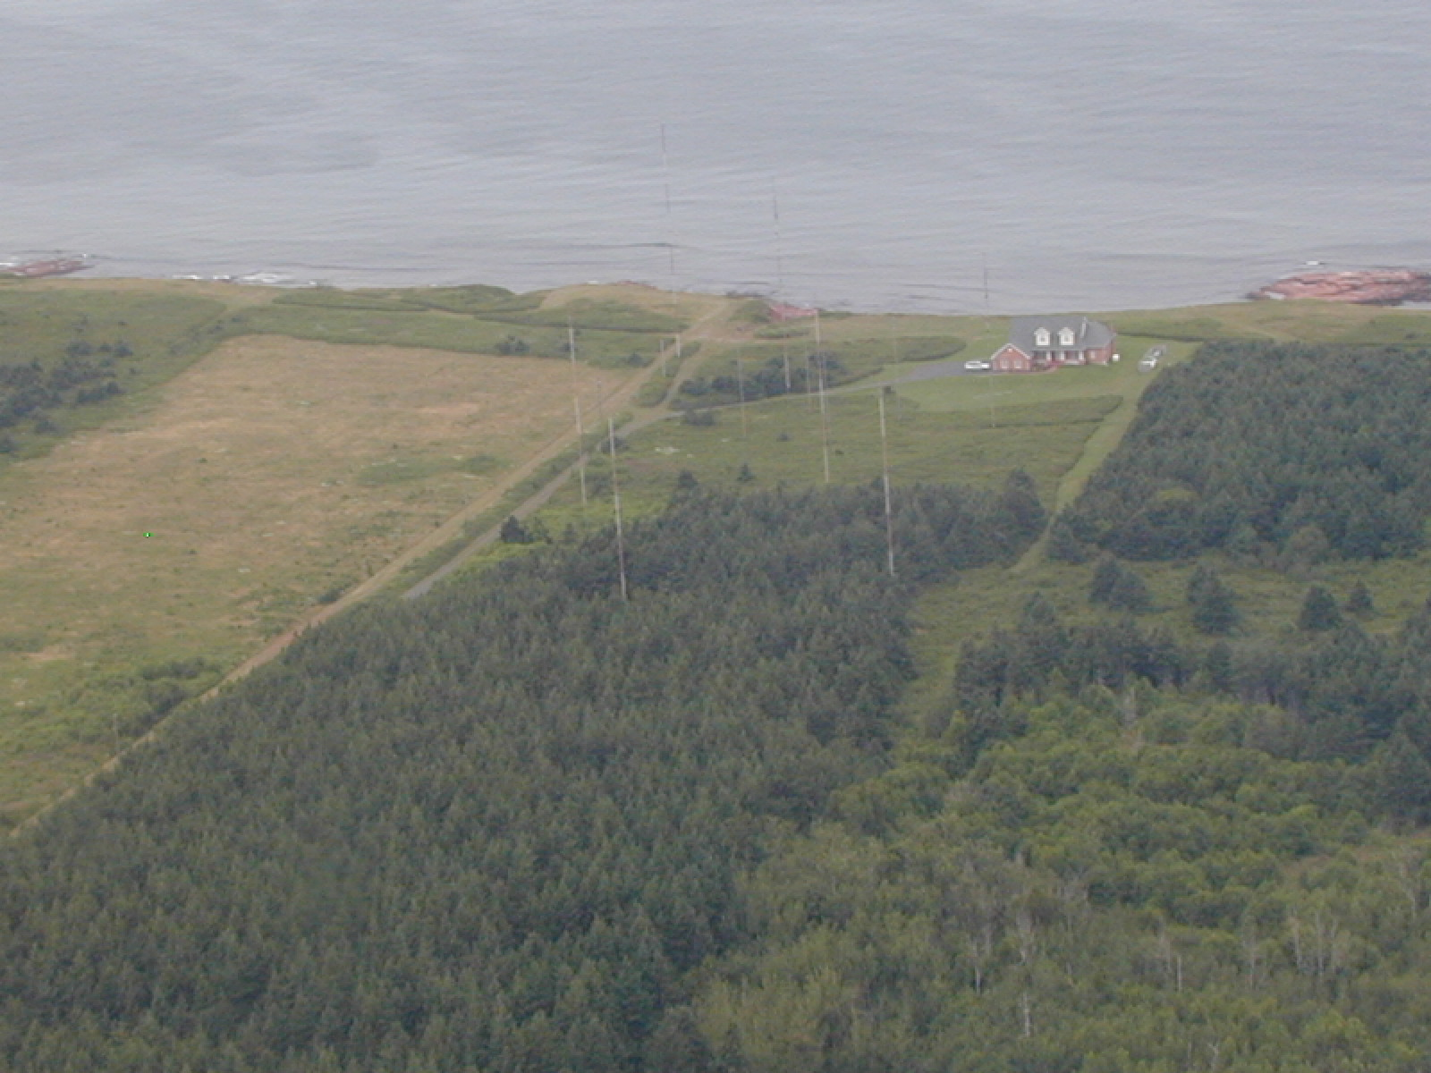
Aerial View Looking North

Slide 38
Special 160M Memories at VY2ZM
9V1GO 160M Phone – Longpath
DU7ET 160M Phone – Shortpath
VK6APZ 160M Phone – Longpath
ST0R 160M Phone
VP8STI 160M Phone
JA Runs at Sunset – 2020z-2210z (40 per day)
JA Runs at Sunrise – 0730z-1150z (100 a day)

Slide 39
Failures: Mfr's Design & My Own!
Example #1 - Too Much Torque for a Tower
Example #2 - Failure of Cushcraft Boom to Mast Clamping System (Aluminium Shear)
Example #3 – Effects of a Salt Water Location

Slide 40
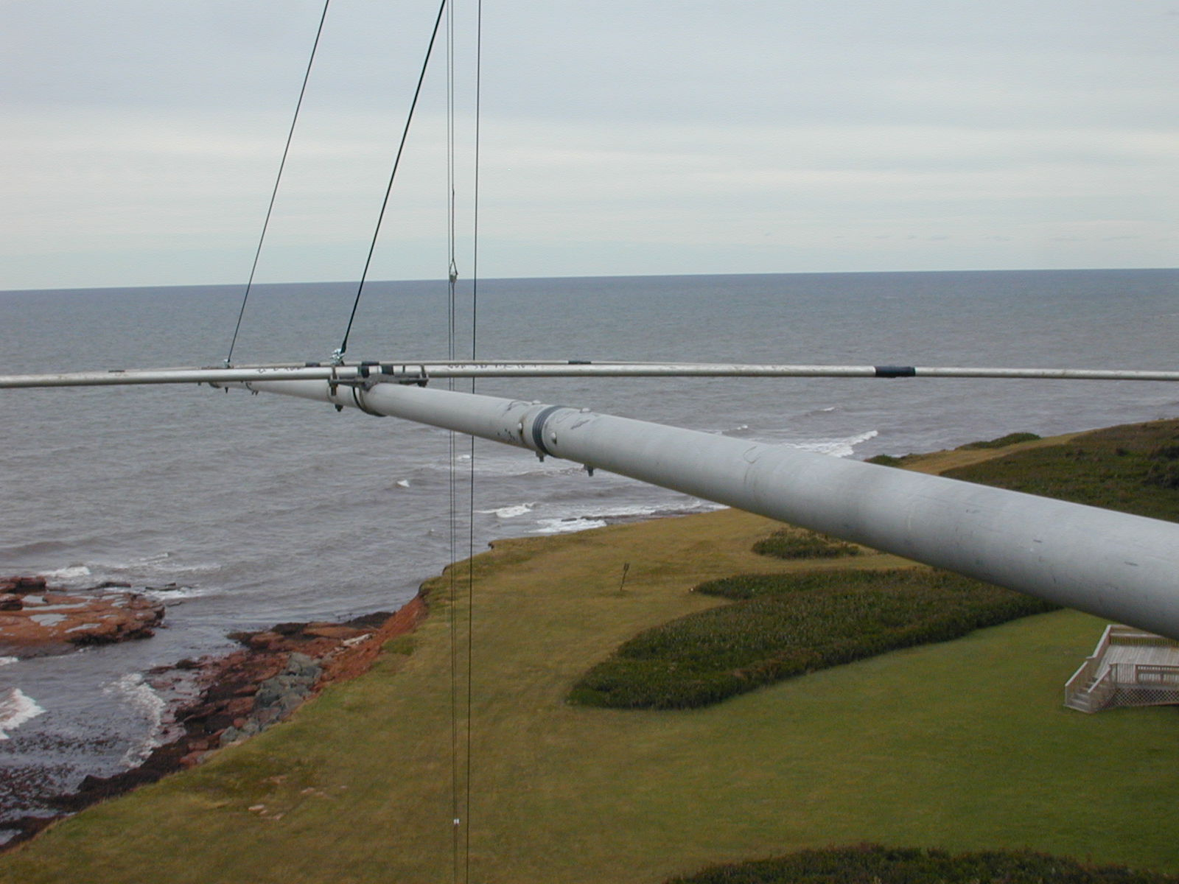
48ft Boom Dir Side Double Trussed

Slide 41
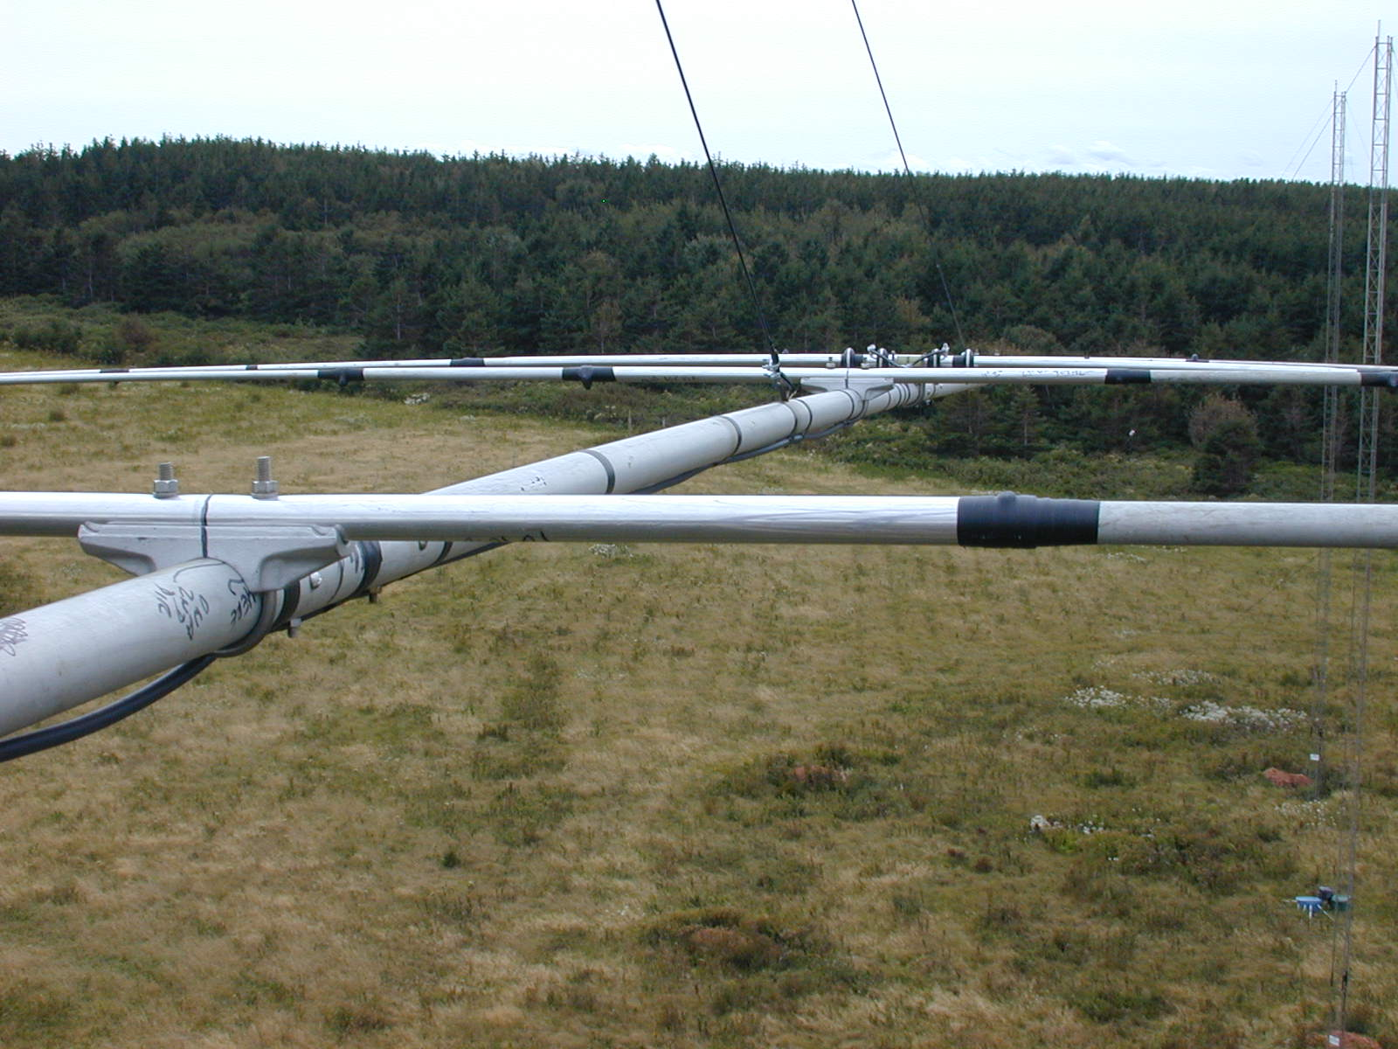
48ft Boom Refl Side Double Trussed

Slide 42
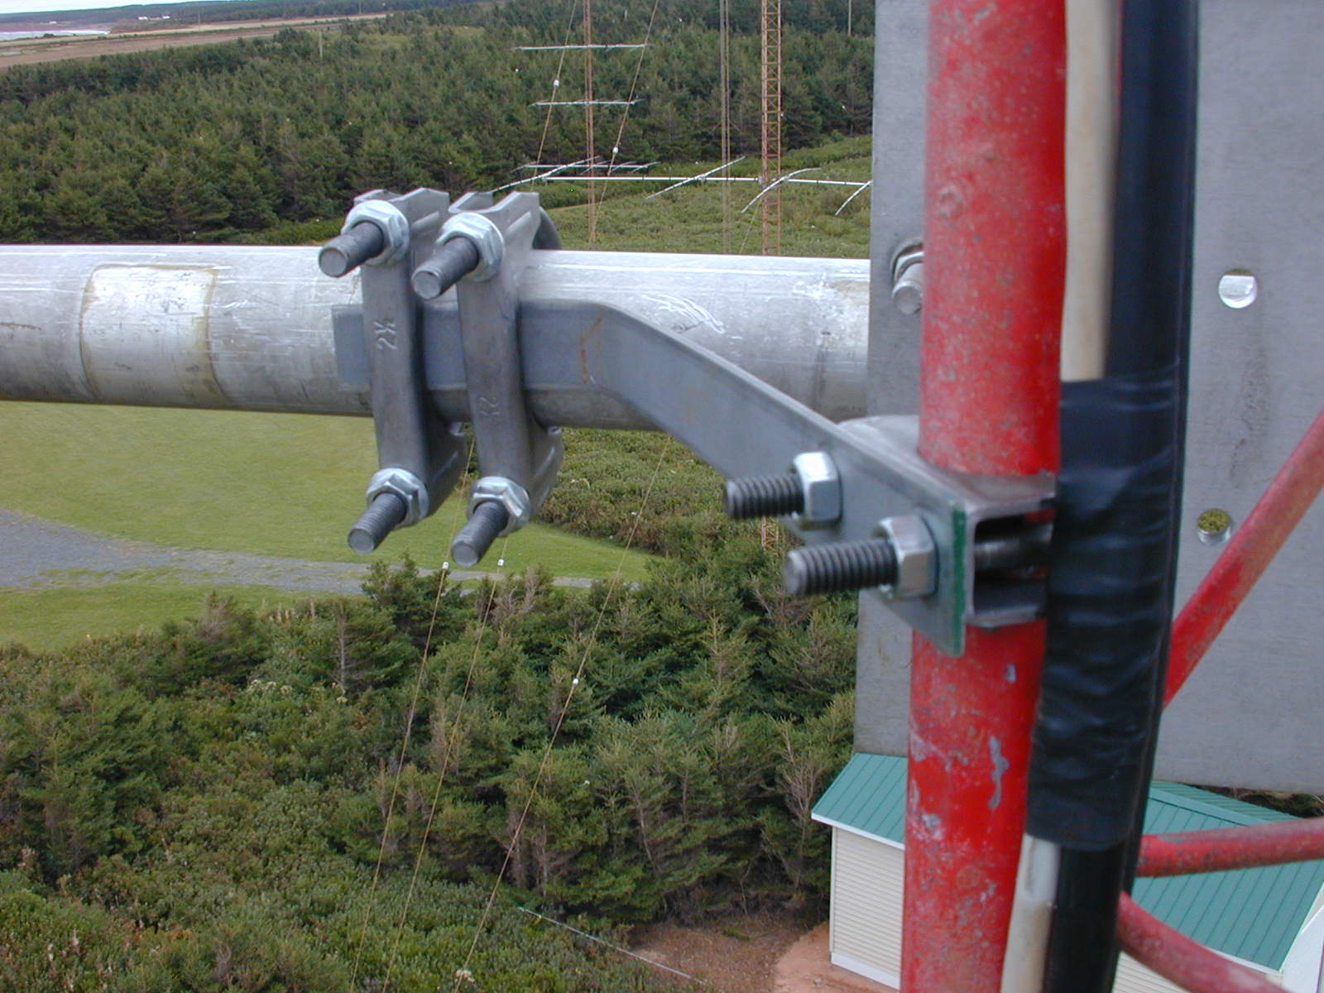
Director Side Bracketing to Tower

Slide 43
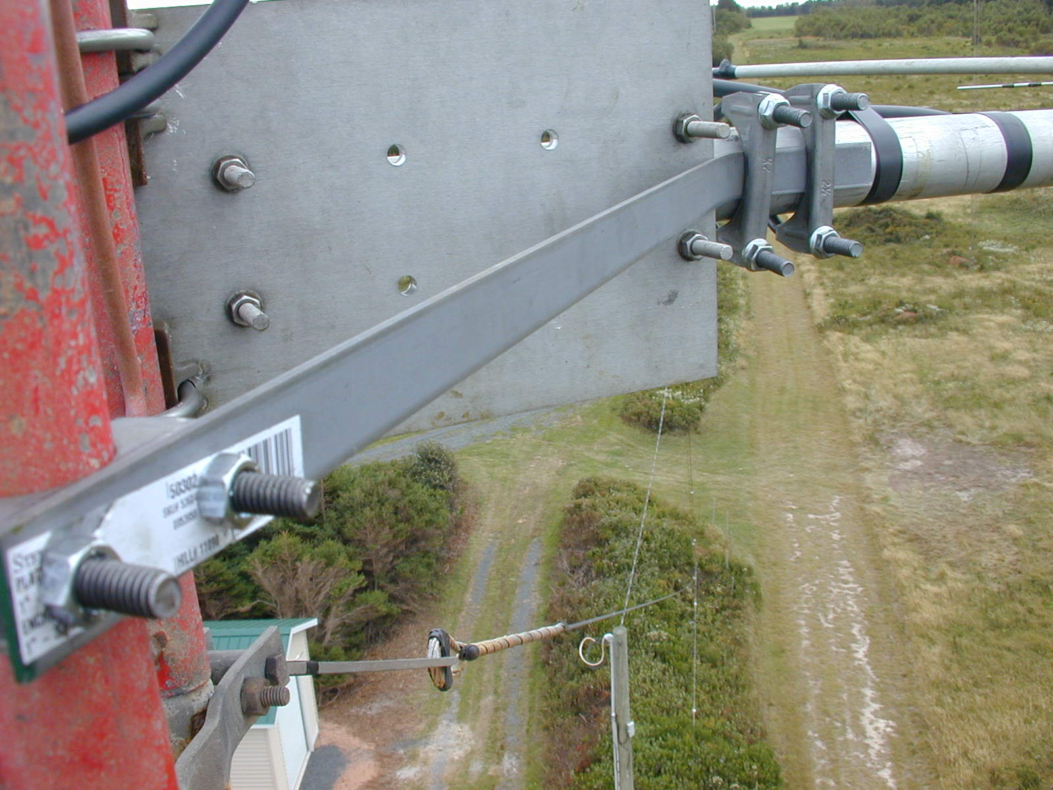
Reflector Side Bracketed to Tower

Slide 44
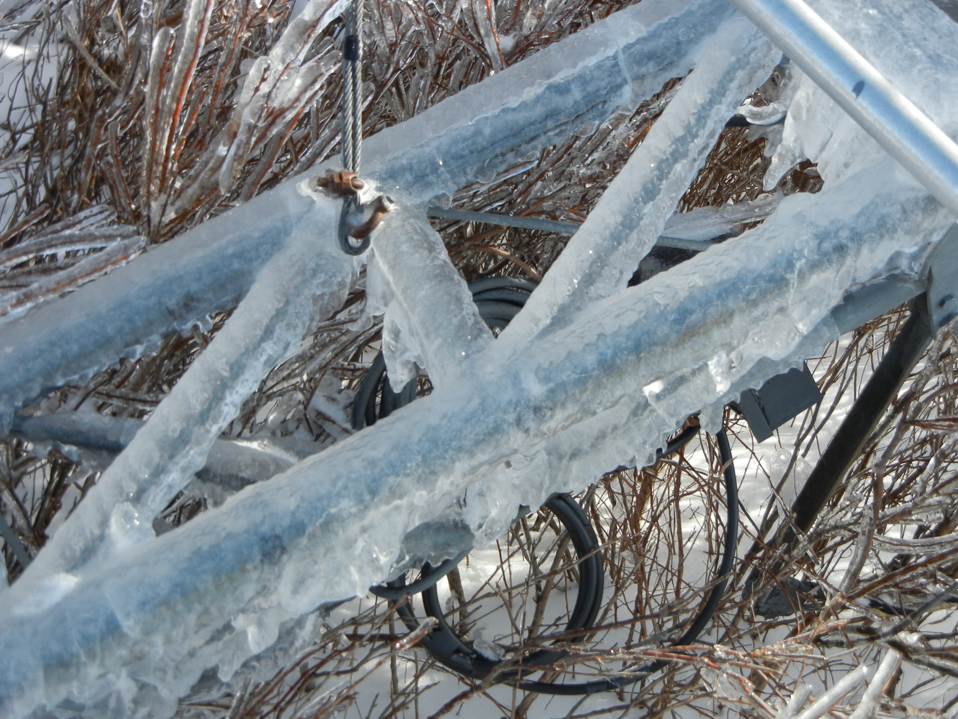
Serious Ice Loading February 2012

Slide 45
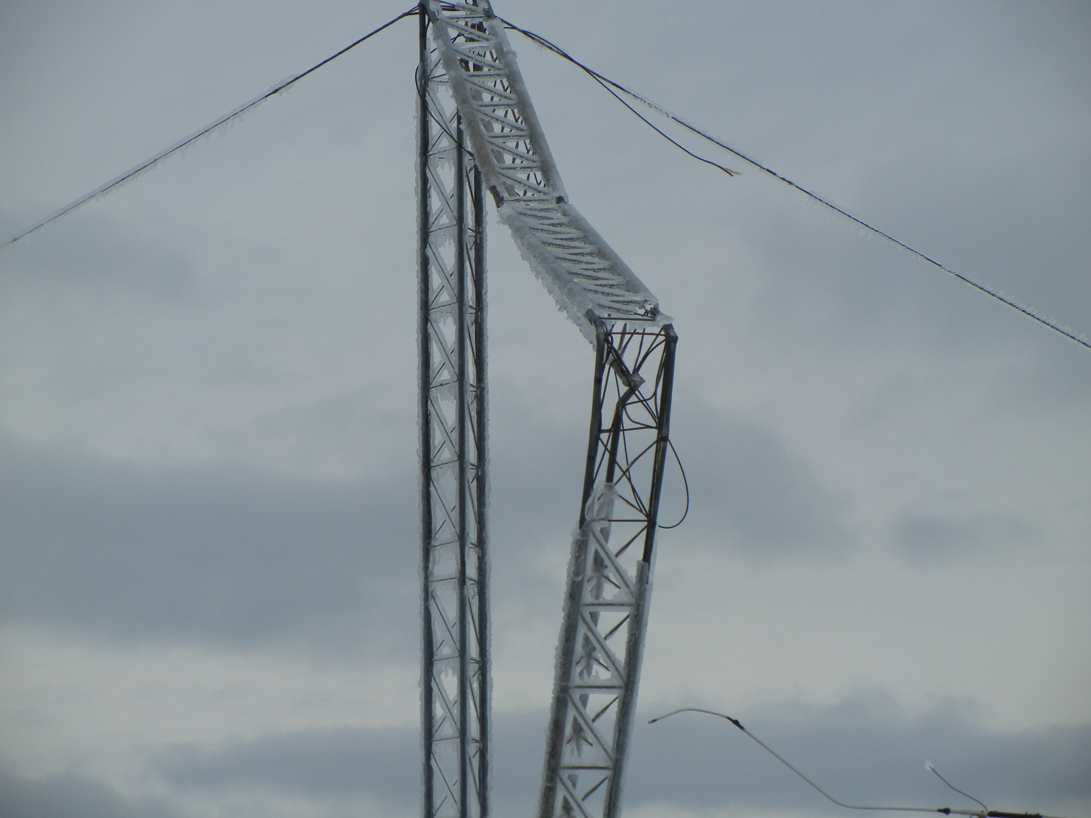
Tower Failure Due to Ice Loading Torque Coupled by High Winds

Slide 46
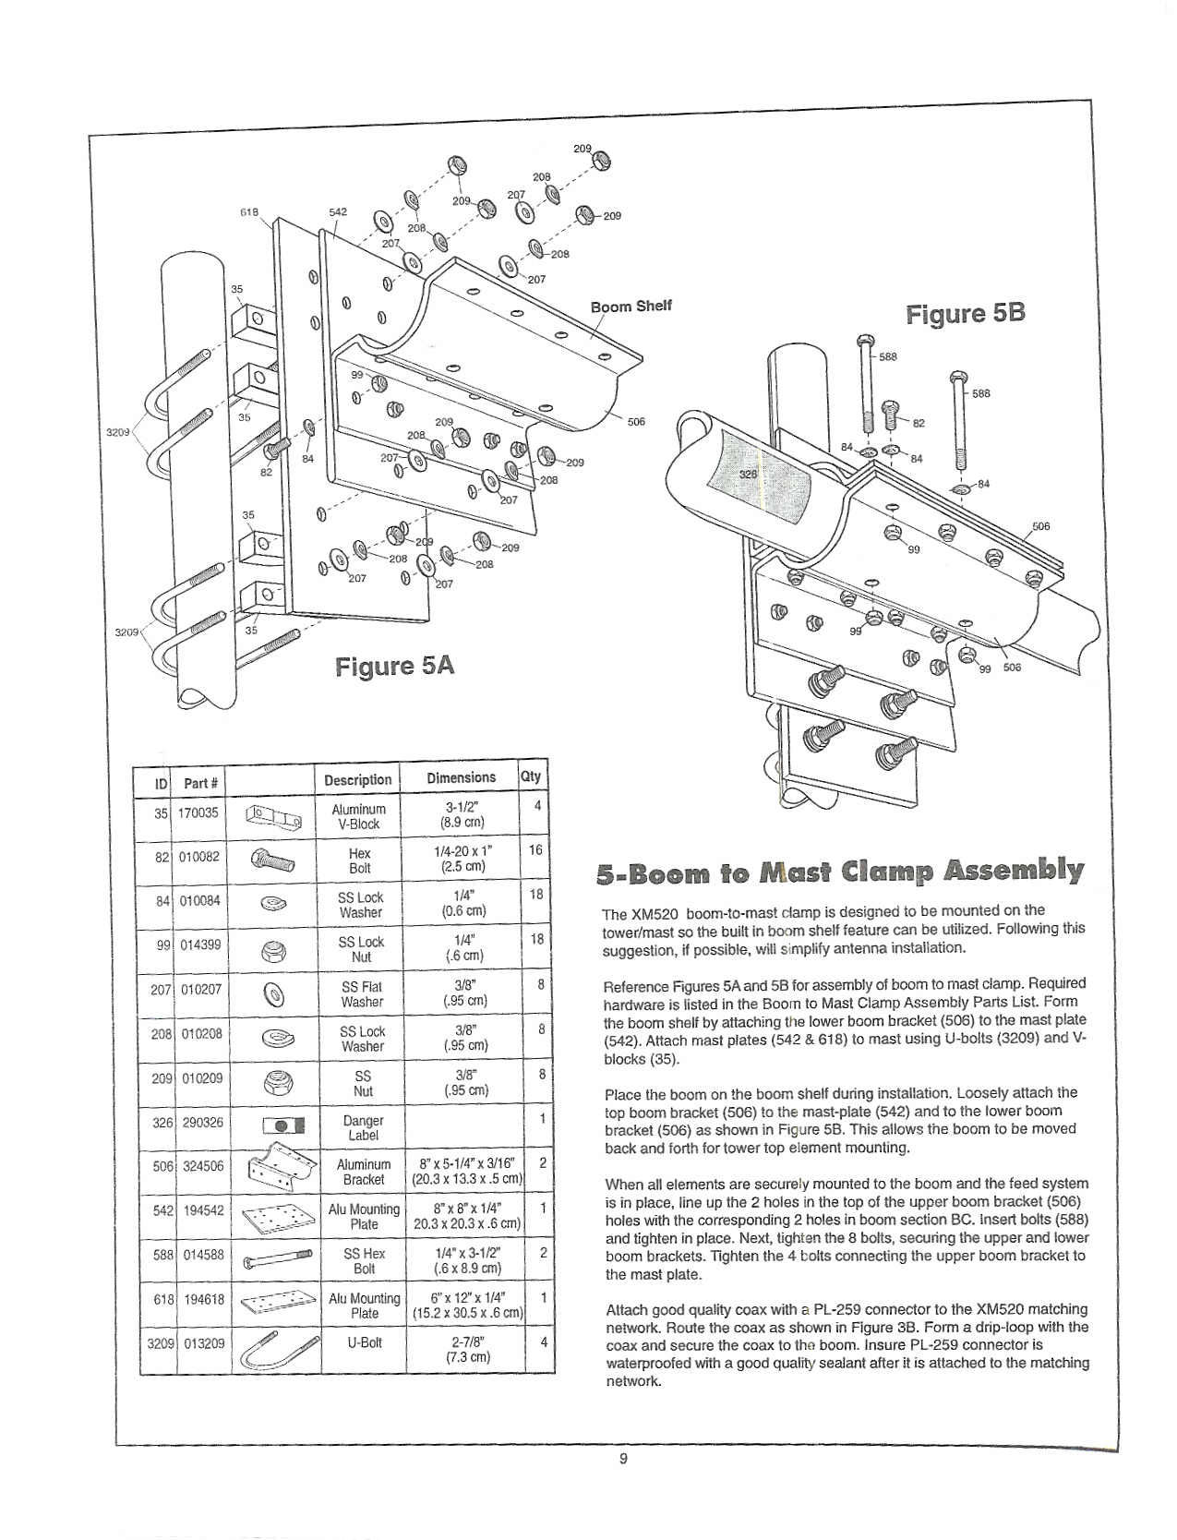
Cushcraft XM Boom to Mast Cradle

Slide 47
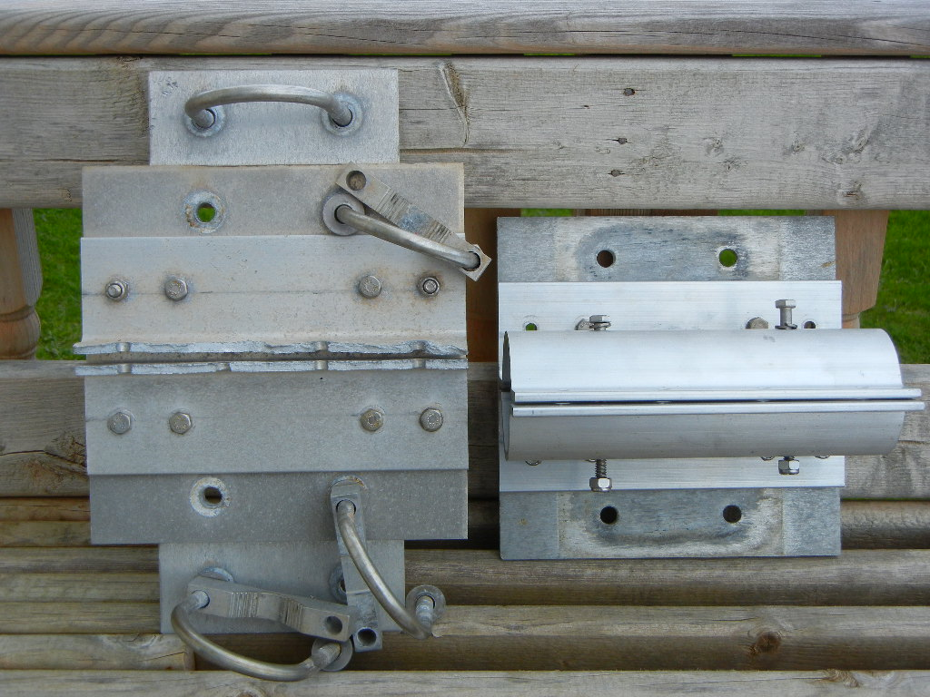
New & Failed XM Mount Side by Side

Slide 48
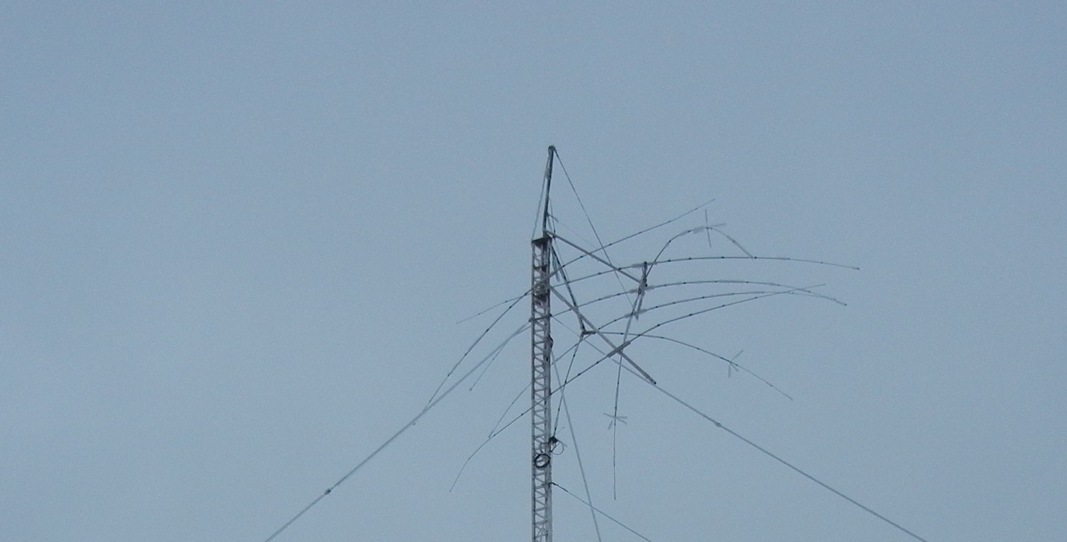
Results of Boom to Mast Shearing!

Slide 49
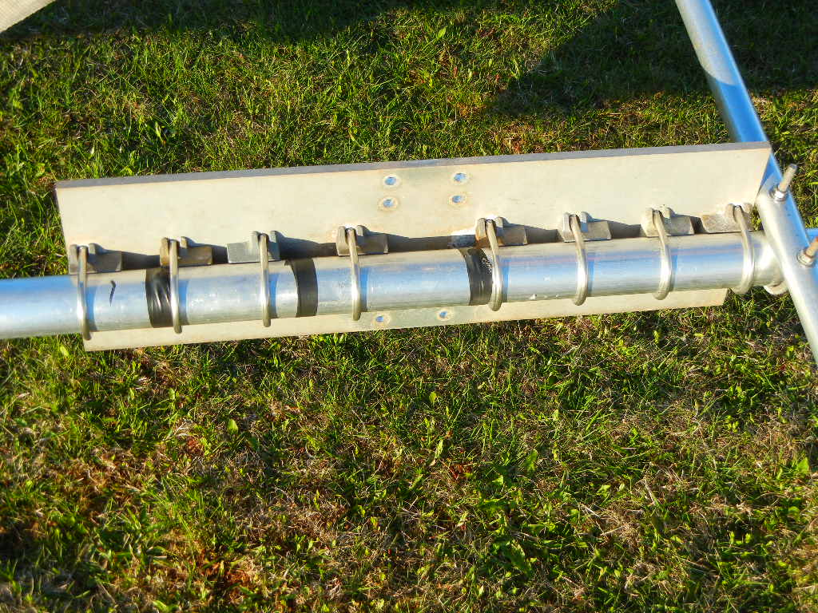
Mosely Boom to Mast
This One Has Some Muscle!

Slide 50
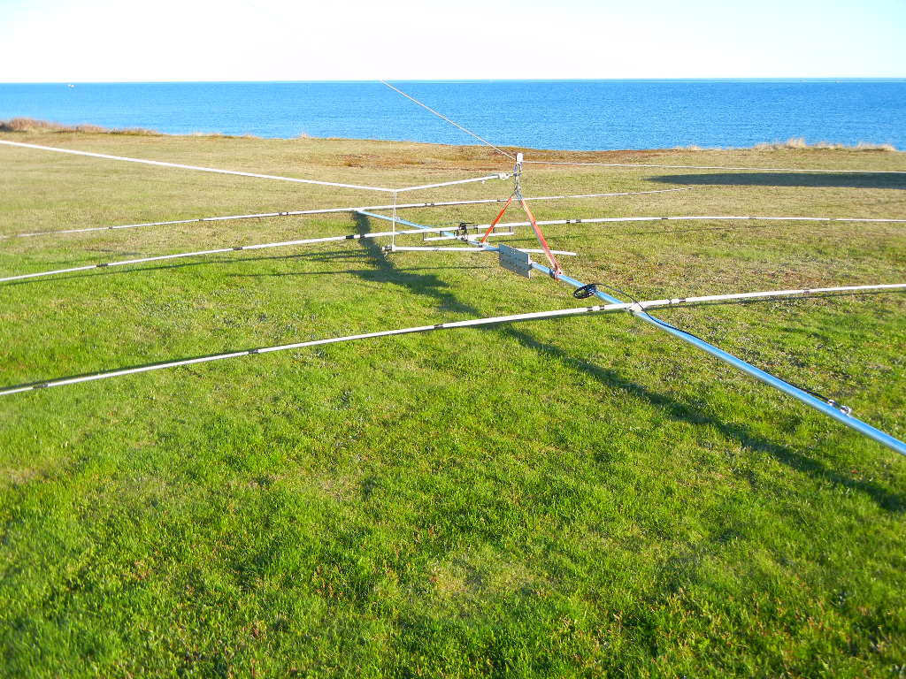
Replacement 20M Yagi Rigged for Tramming

Slide 51
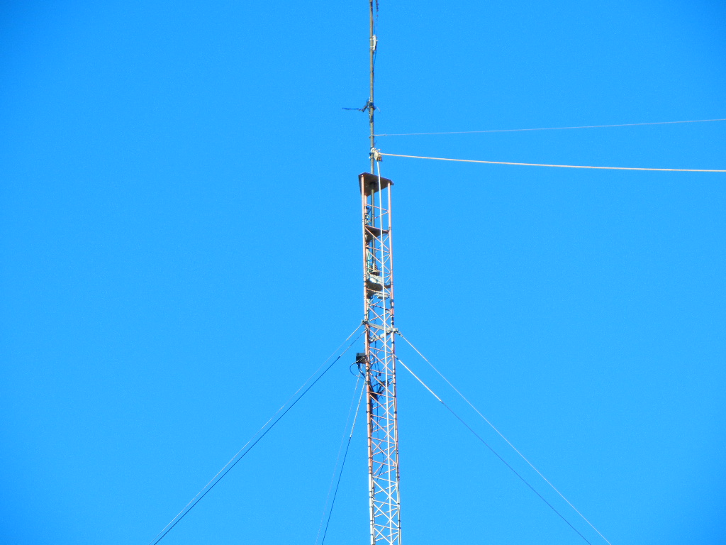
Top of Tower Rigged for Tramming

Slide 52
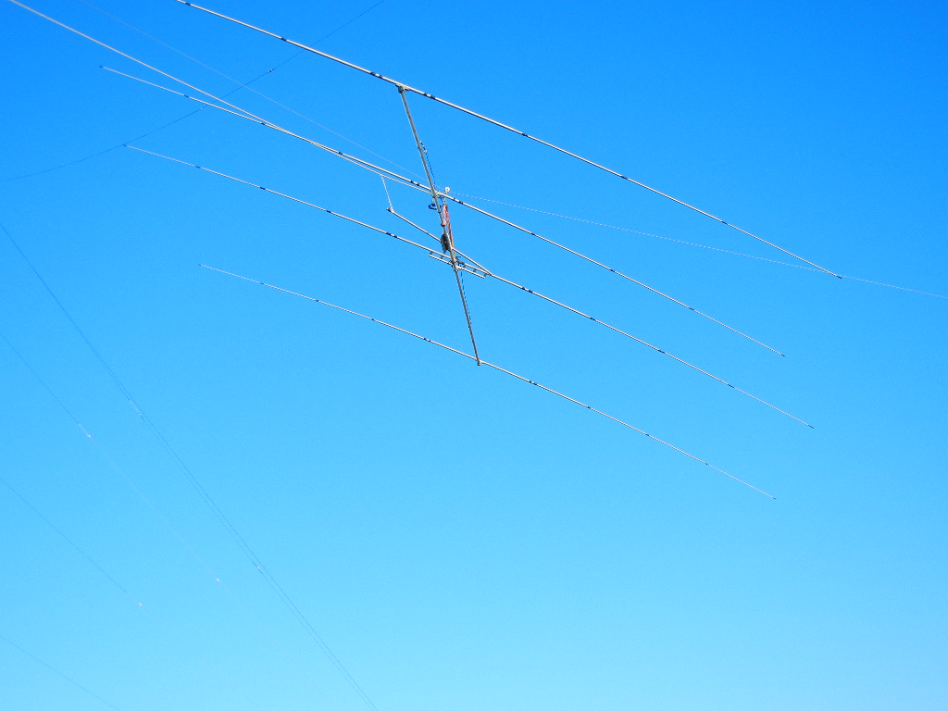
20M Yagi ½ Way Up to 135 Feet

Slide 53
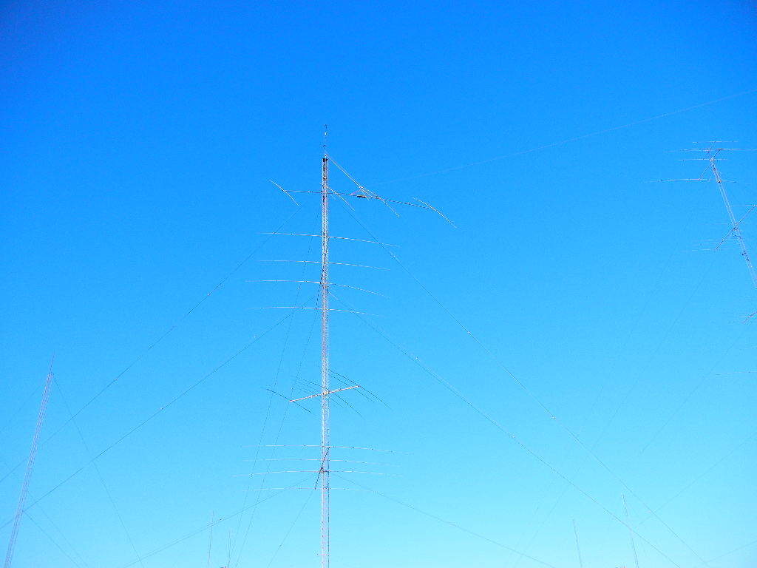
Antenna is Almost There

Slide 54
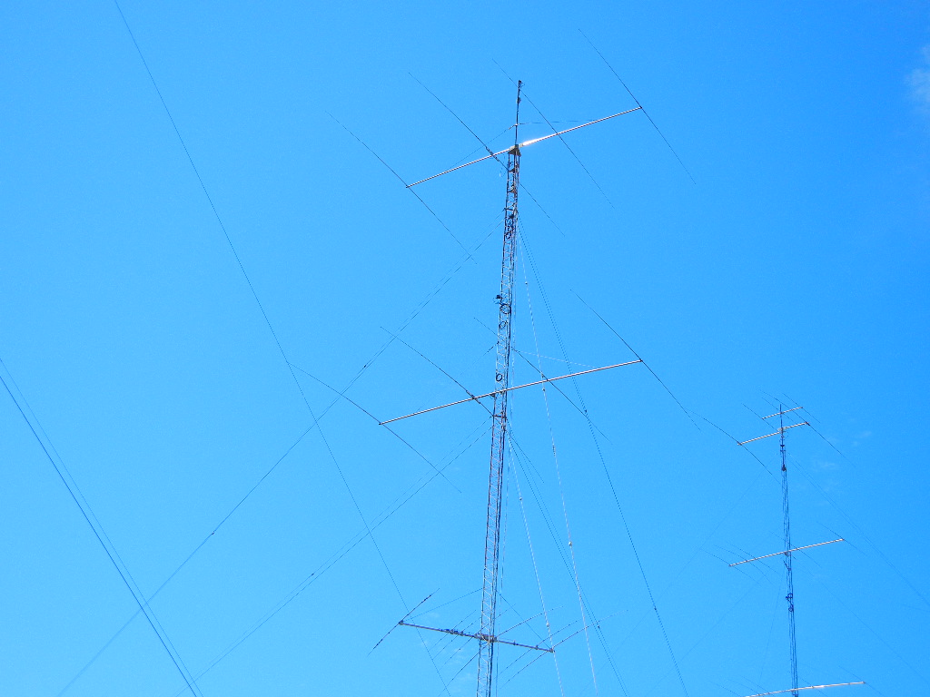
20M Stacks Again Operational

Slide 55
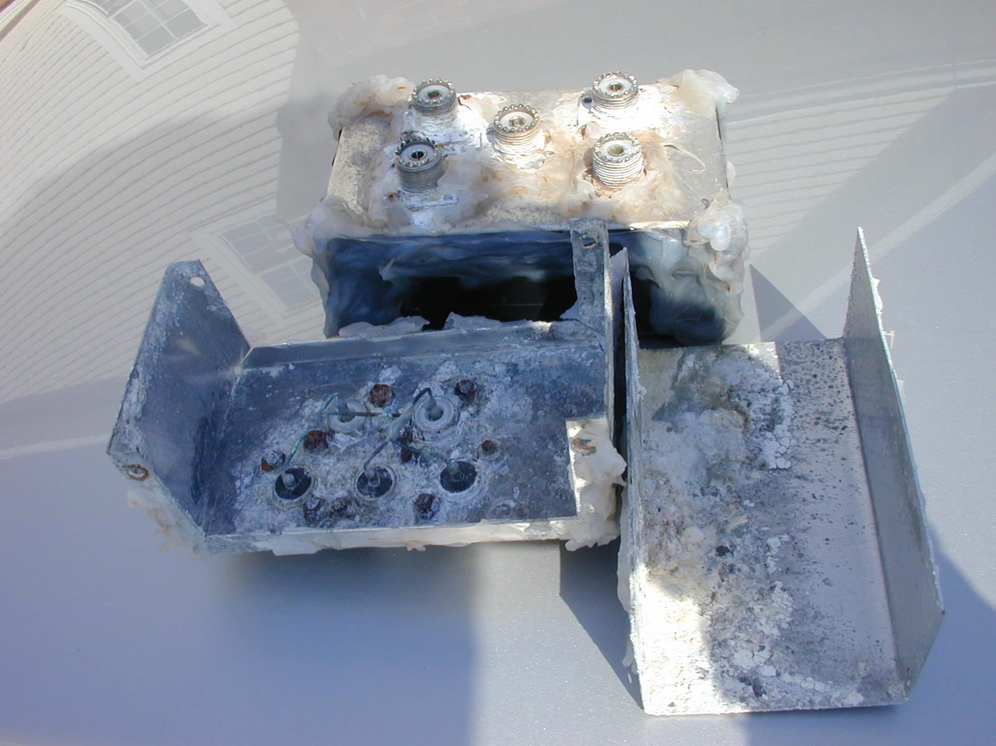
Even Good Engineering Fails

Slide 56
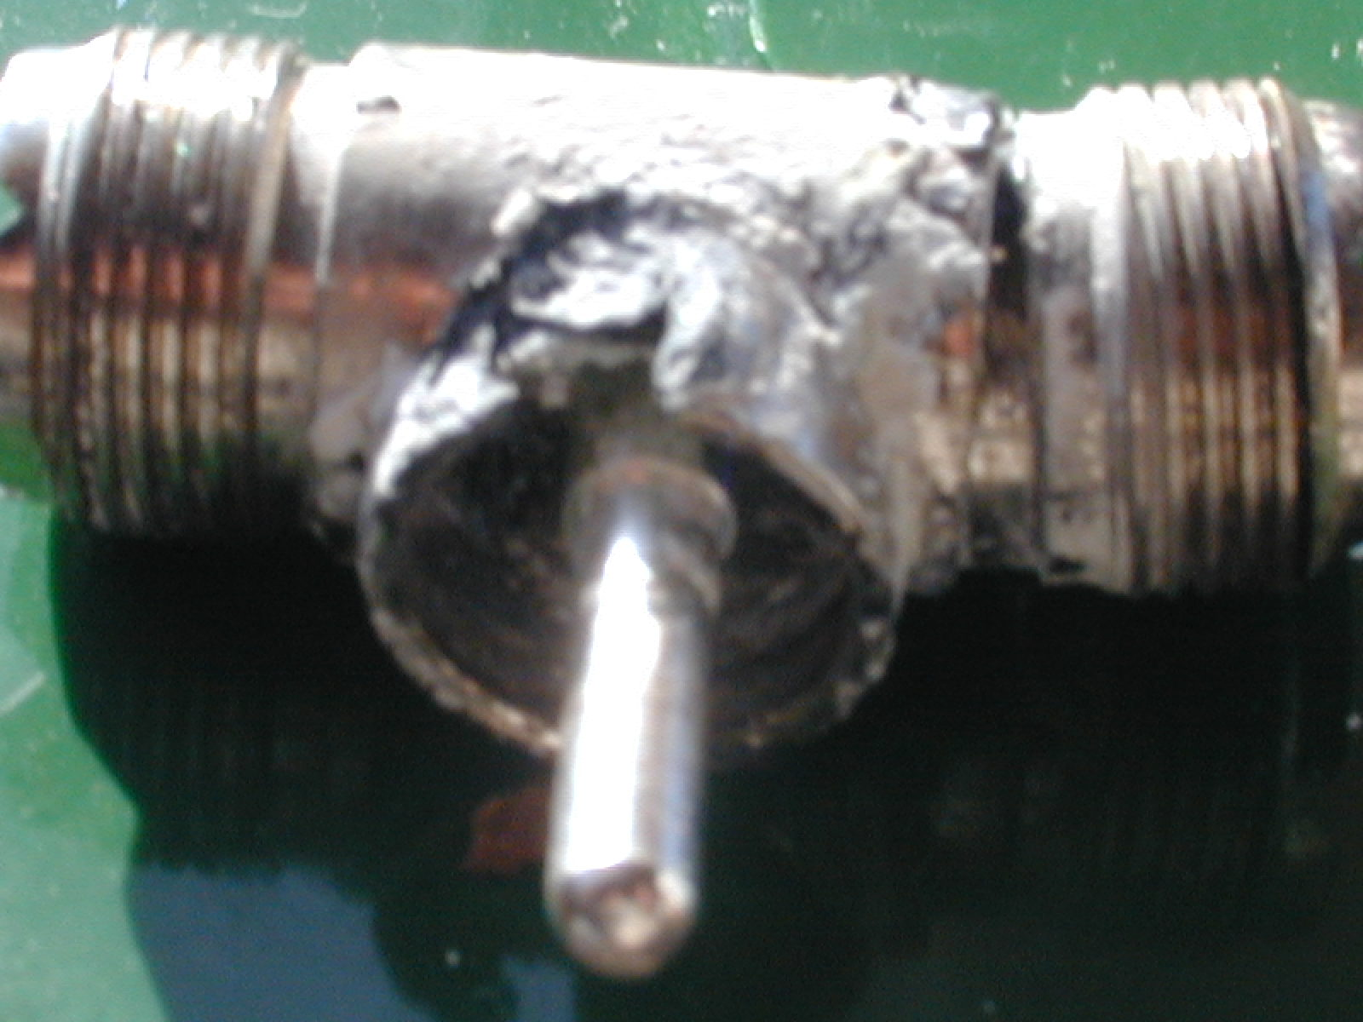
Salt Spray Finds a Way In!

Slide 57
A Few Contesting/DX Achievements
Several World/N. American/Canadian Records
#2 World Single-Op All Band in CQWW
Multiple Top 5 Finishes Single Op A/B CQWW
16 Single-Op All Band Wins for W/VE ARRL DX
WAZ 40 Single Band 160M
DXCC Honor Roll Achieved Single Band 160M
(The ABOVE is probably worth a cupper at your local Starbucks!!!)

Slide 58
A Few Lessons Learned Along the Way.....
A quiet location free from man-made noise is vital to low band success
Maximizing Low Band Antenna gain is critical
Verticals along the ocean are top performers
Yagis (and other horizontally polarized antennas) are no better along the ocean than placement on a hilltop inland
Antenna RDF can eliminate the need for Beverage and/or other Rx Listening Antennas

Slide 59
Thanks for Coming – Hope to CU in the Next Contest!

Slide 60


Contesting from VY2ZM on PEI
By Jeff Briggs, VY2ZM

